Slide 1
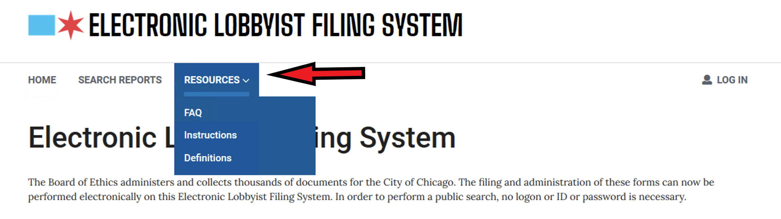
Before beginning. Just a reminder that clicking the Resources link at the top of all the pages in ELF you can find links to Instructions, FAQ’s and Definitions.

Slide 2
Registering as a Lobbyist
These instructions will walk you through, screen by screen, how to use the Electronic Lobbyist Filing System (ELF) to register as a lobbyist. There are other presentations for Activity Reports and Termination.
The ELF is found at this website: https://webapps1.chicago.gov/elf/index.html

Slide 3
If you are a new lobbyist and have never registered before, please follow the directions below.
If you are already registered and want to add more clients to your registration - begin at slide 16.
For other instructions and helps, please click the RESOURCES button at the top of the ELF screens

Slide 4
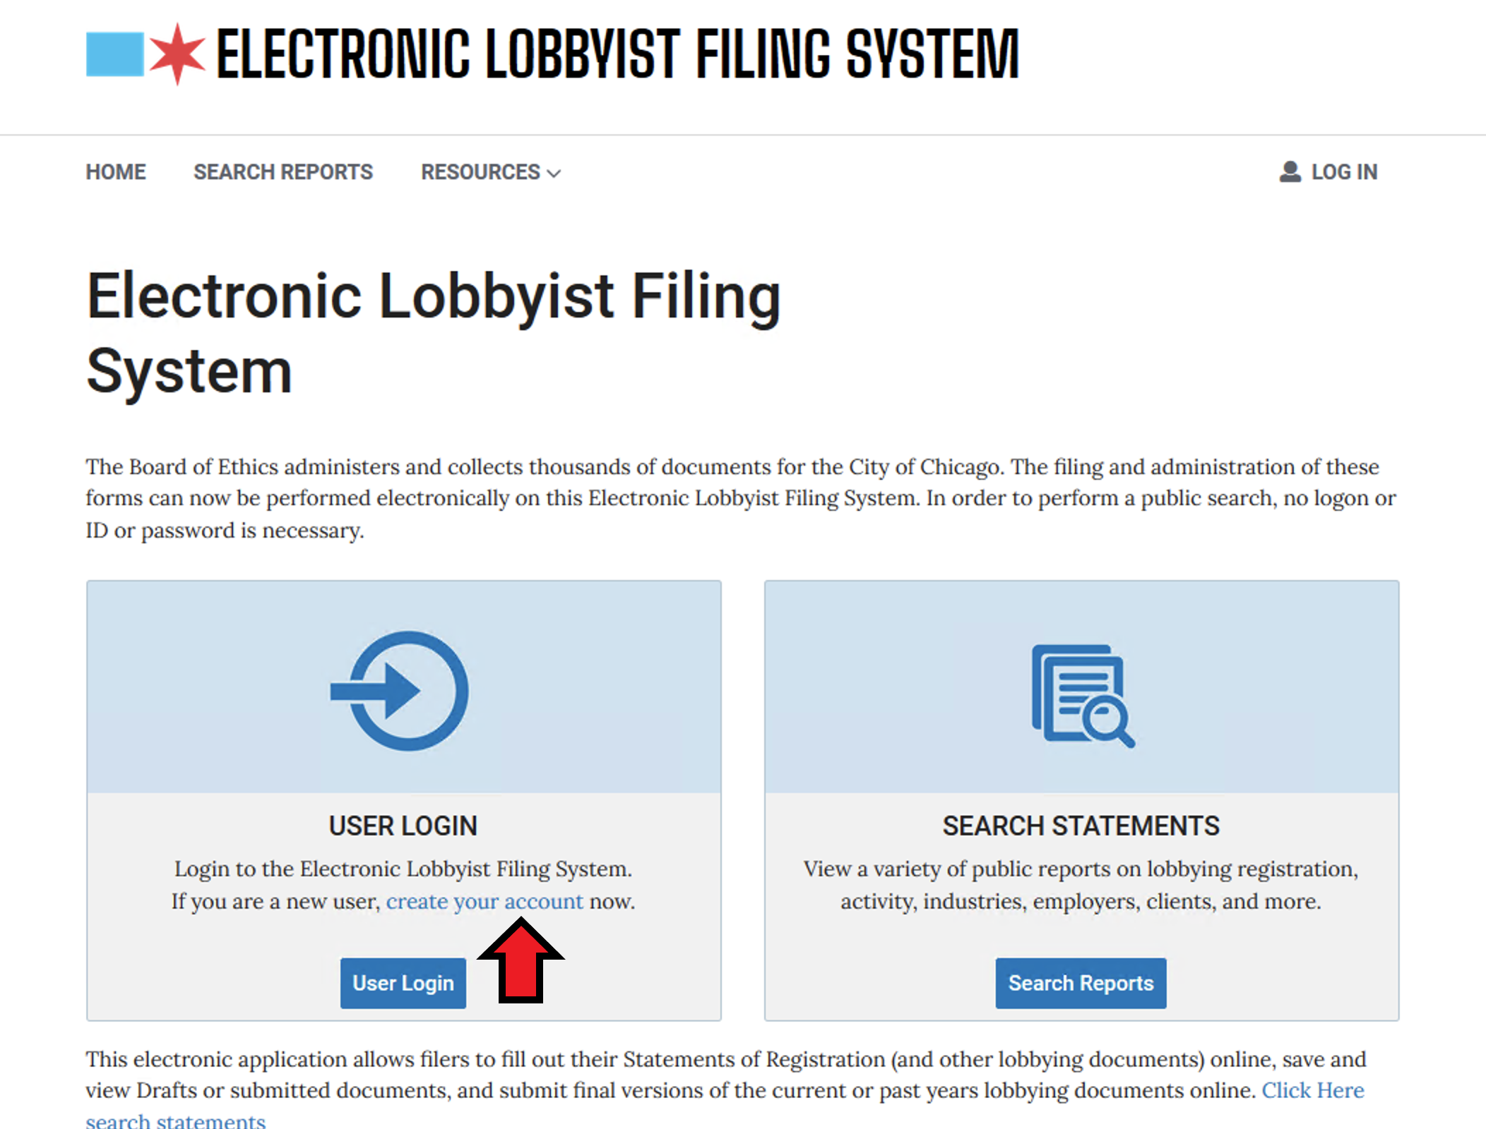
For new lobbyists, you will have to create your login name and password. Click on Create Your Account

Slide 5
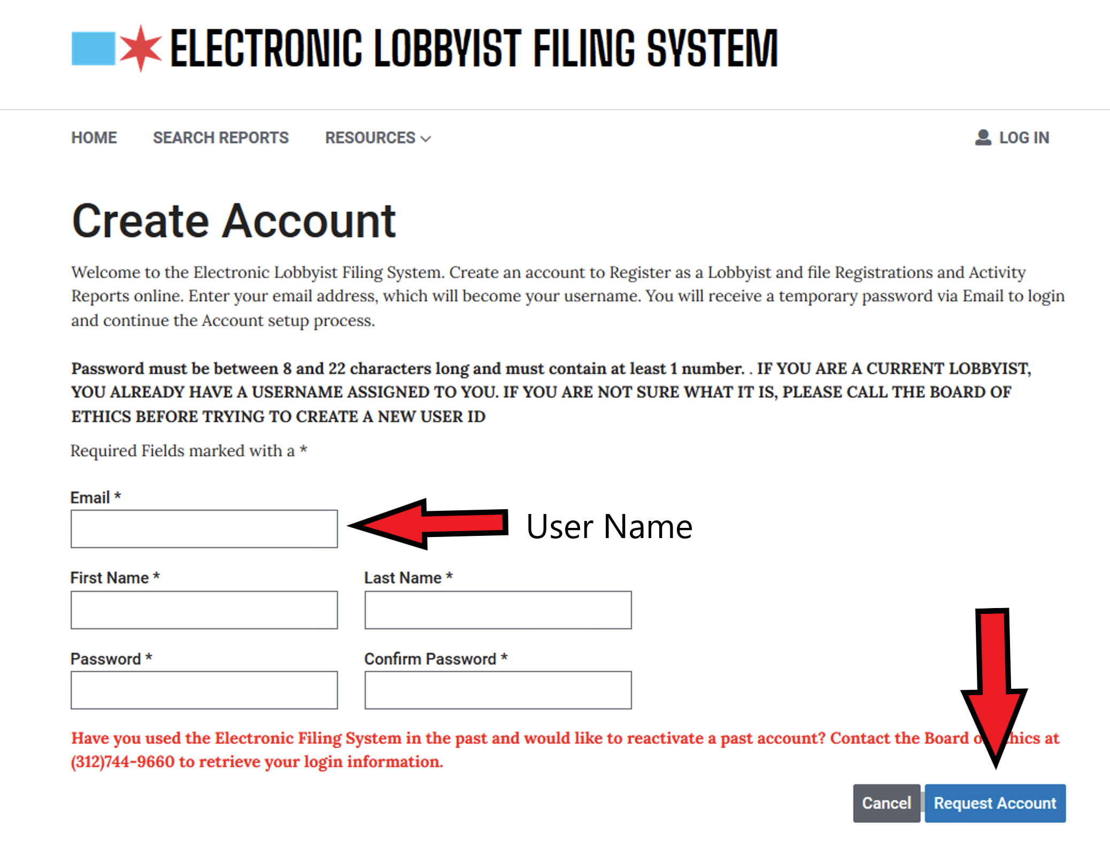
Provide all the requested information and click the Request Account button. The email address you provide at this step is also your login user-name This should be unique for each lobbyist.

Slide 6
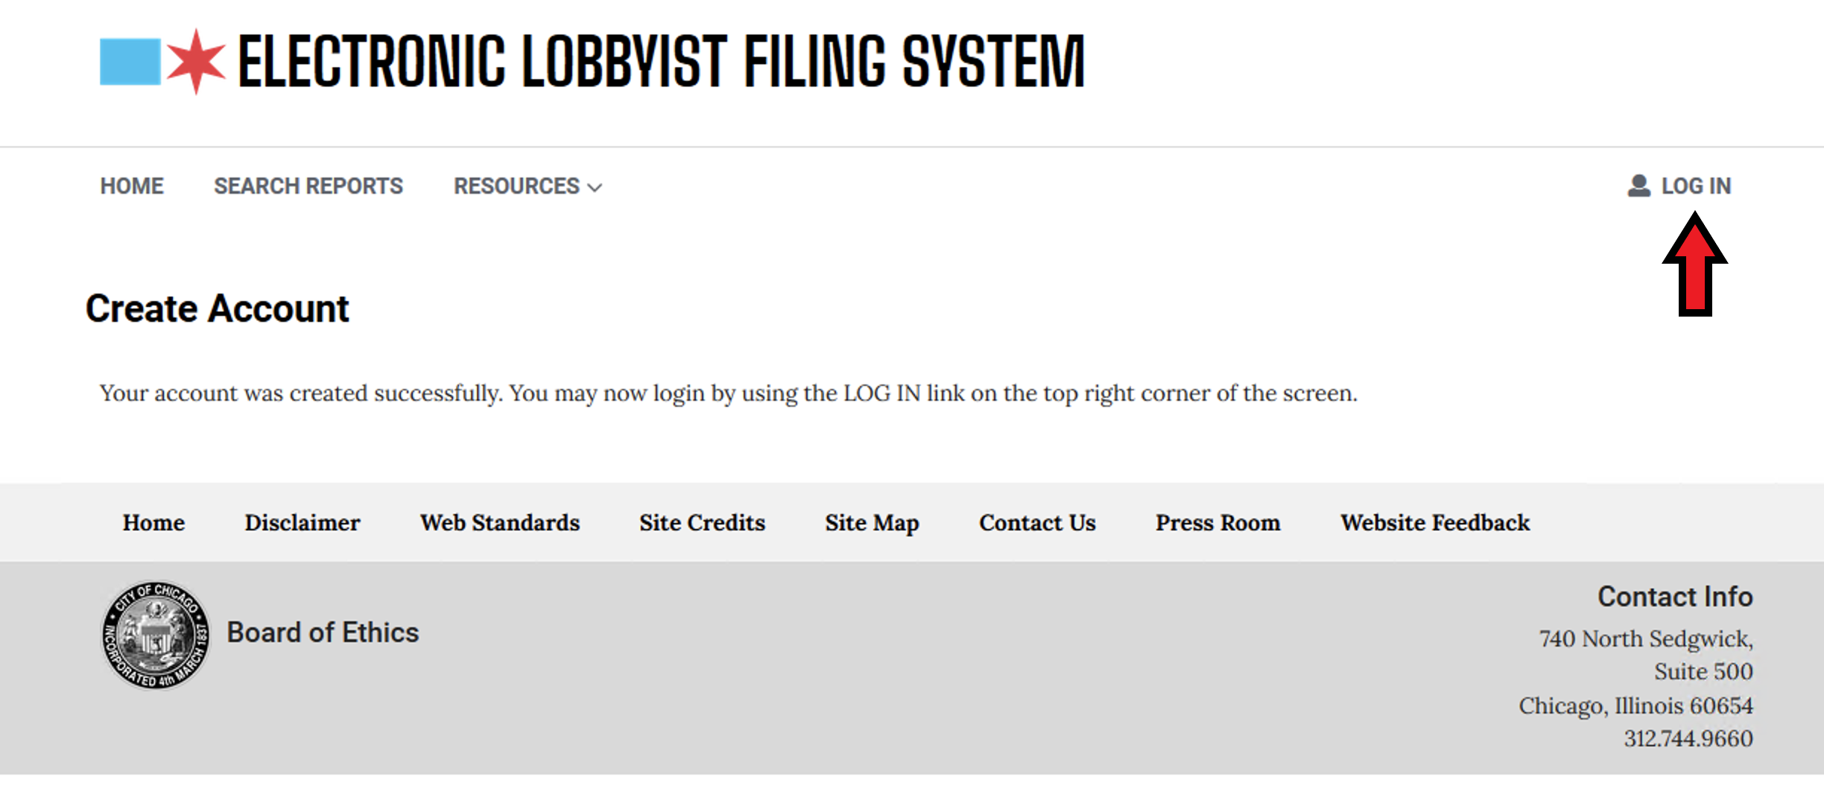
After creating your account you may then log in to ELF. Use the Log In button

Slide 7
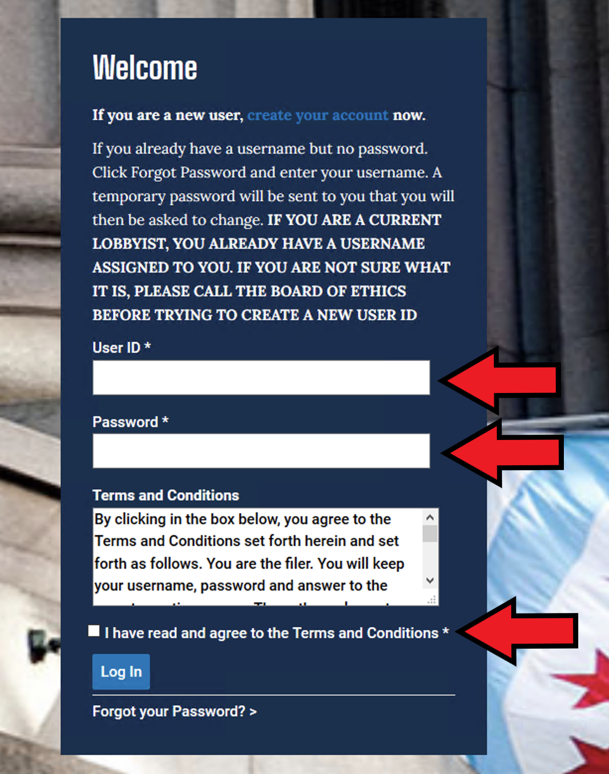
Put in your username, password and be sure to click the box that said you read the terms and conditions and then hit Log In.

Slide 8
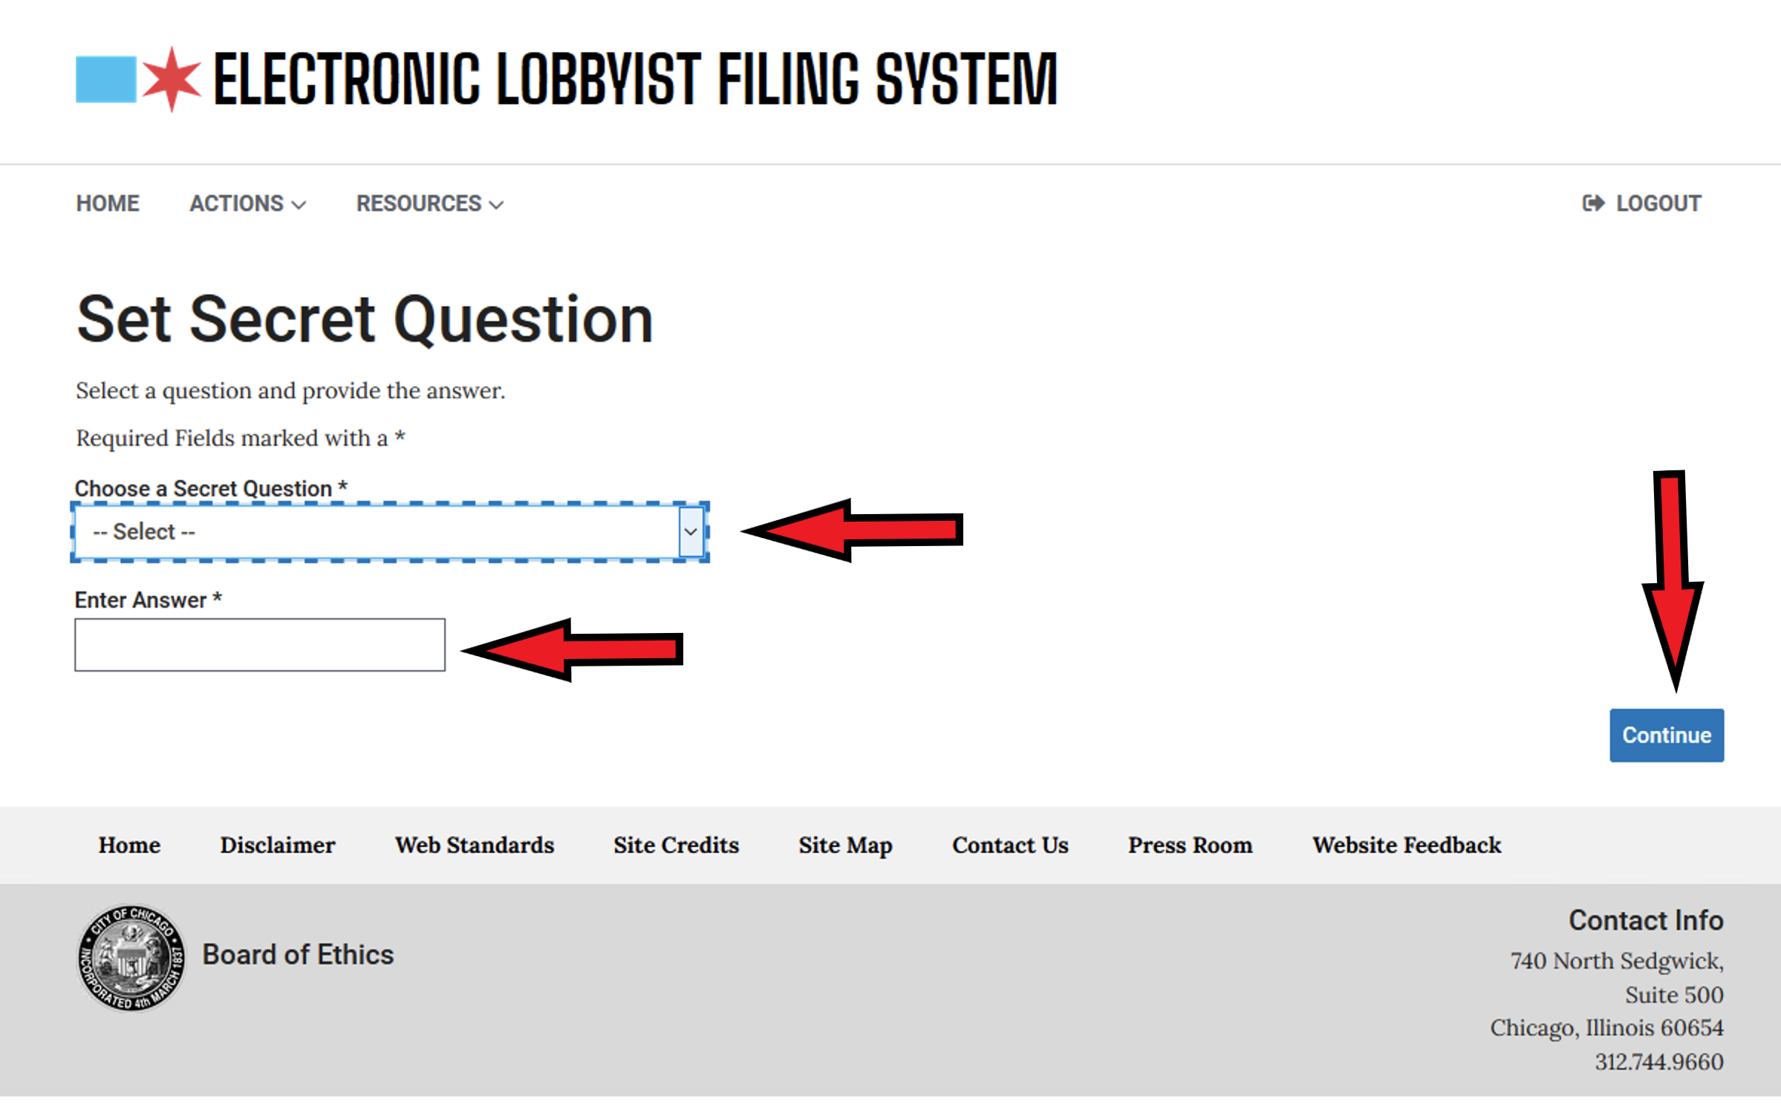
After logging in, Choose a security question and provide the answer. Choose Continue.

Slide 9
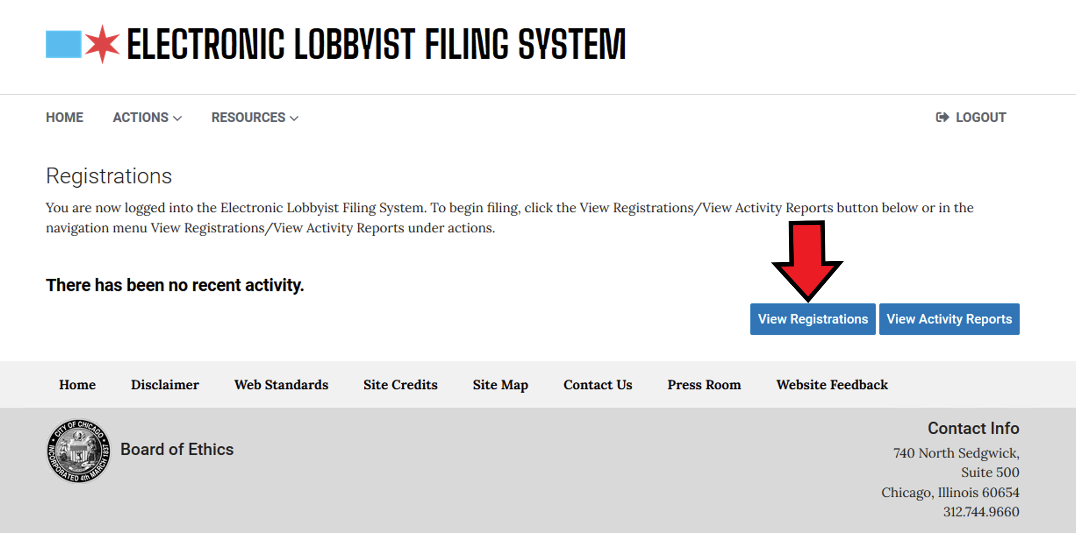
At this window, choose View Registrations

Slide 10
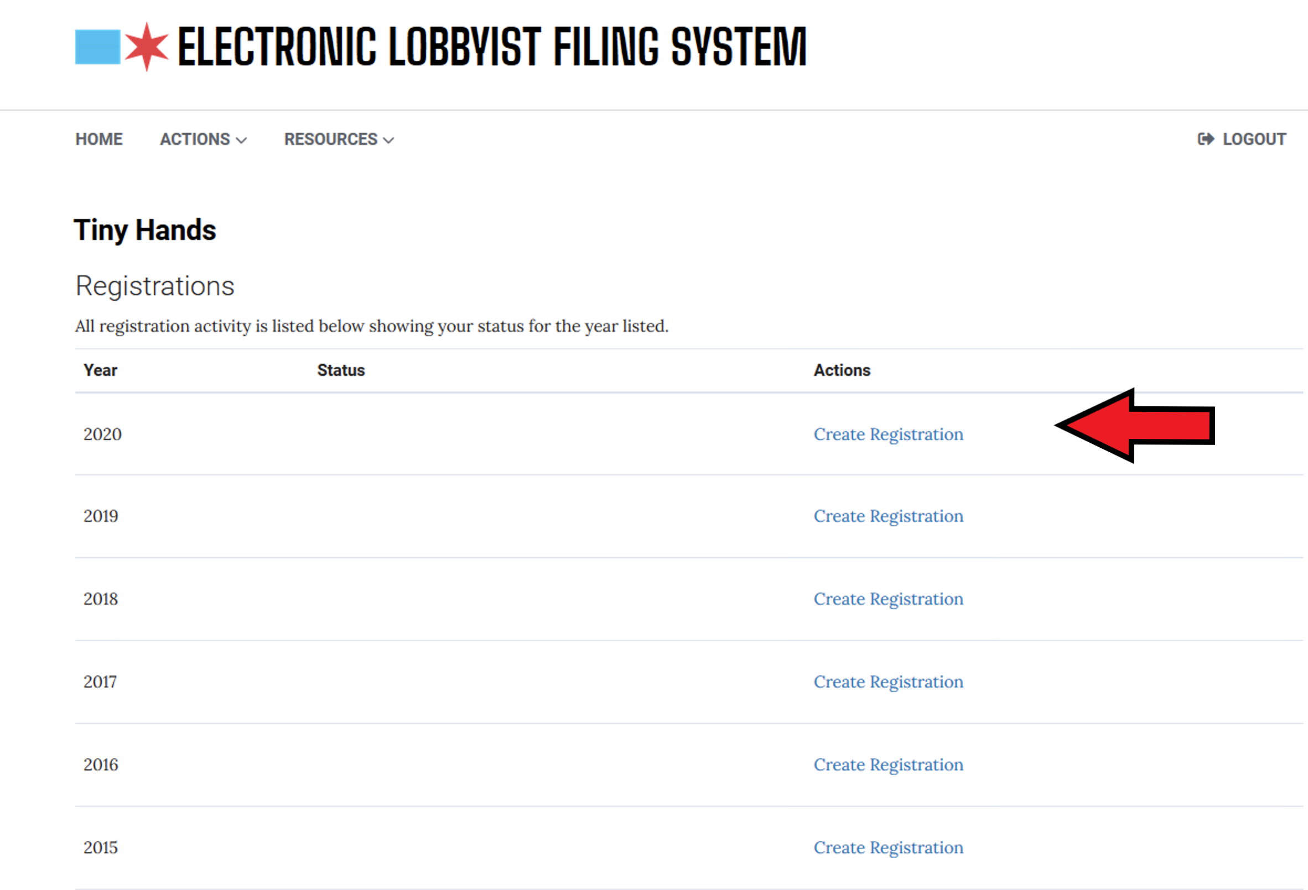
In the proper year choose Create Registration

Slide 11
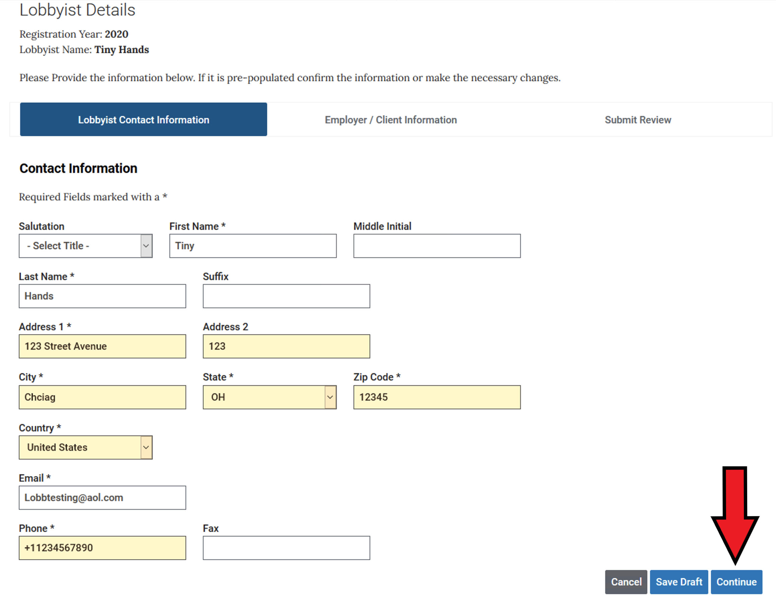
Provide the Lobbyist Details (if pre-populated make sure it is correct) and hit Continue

Slide 12
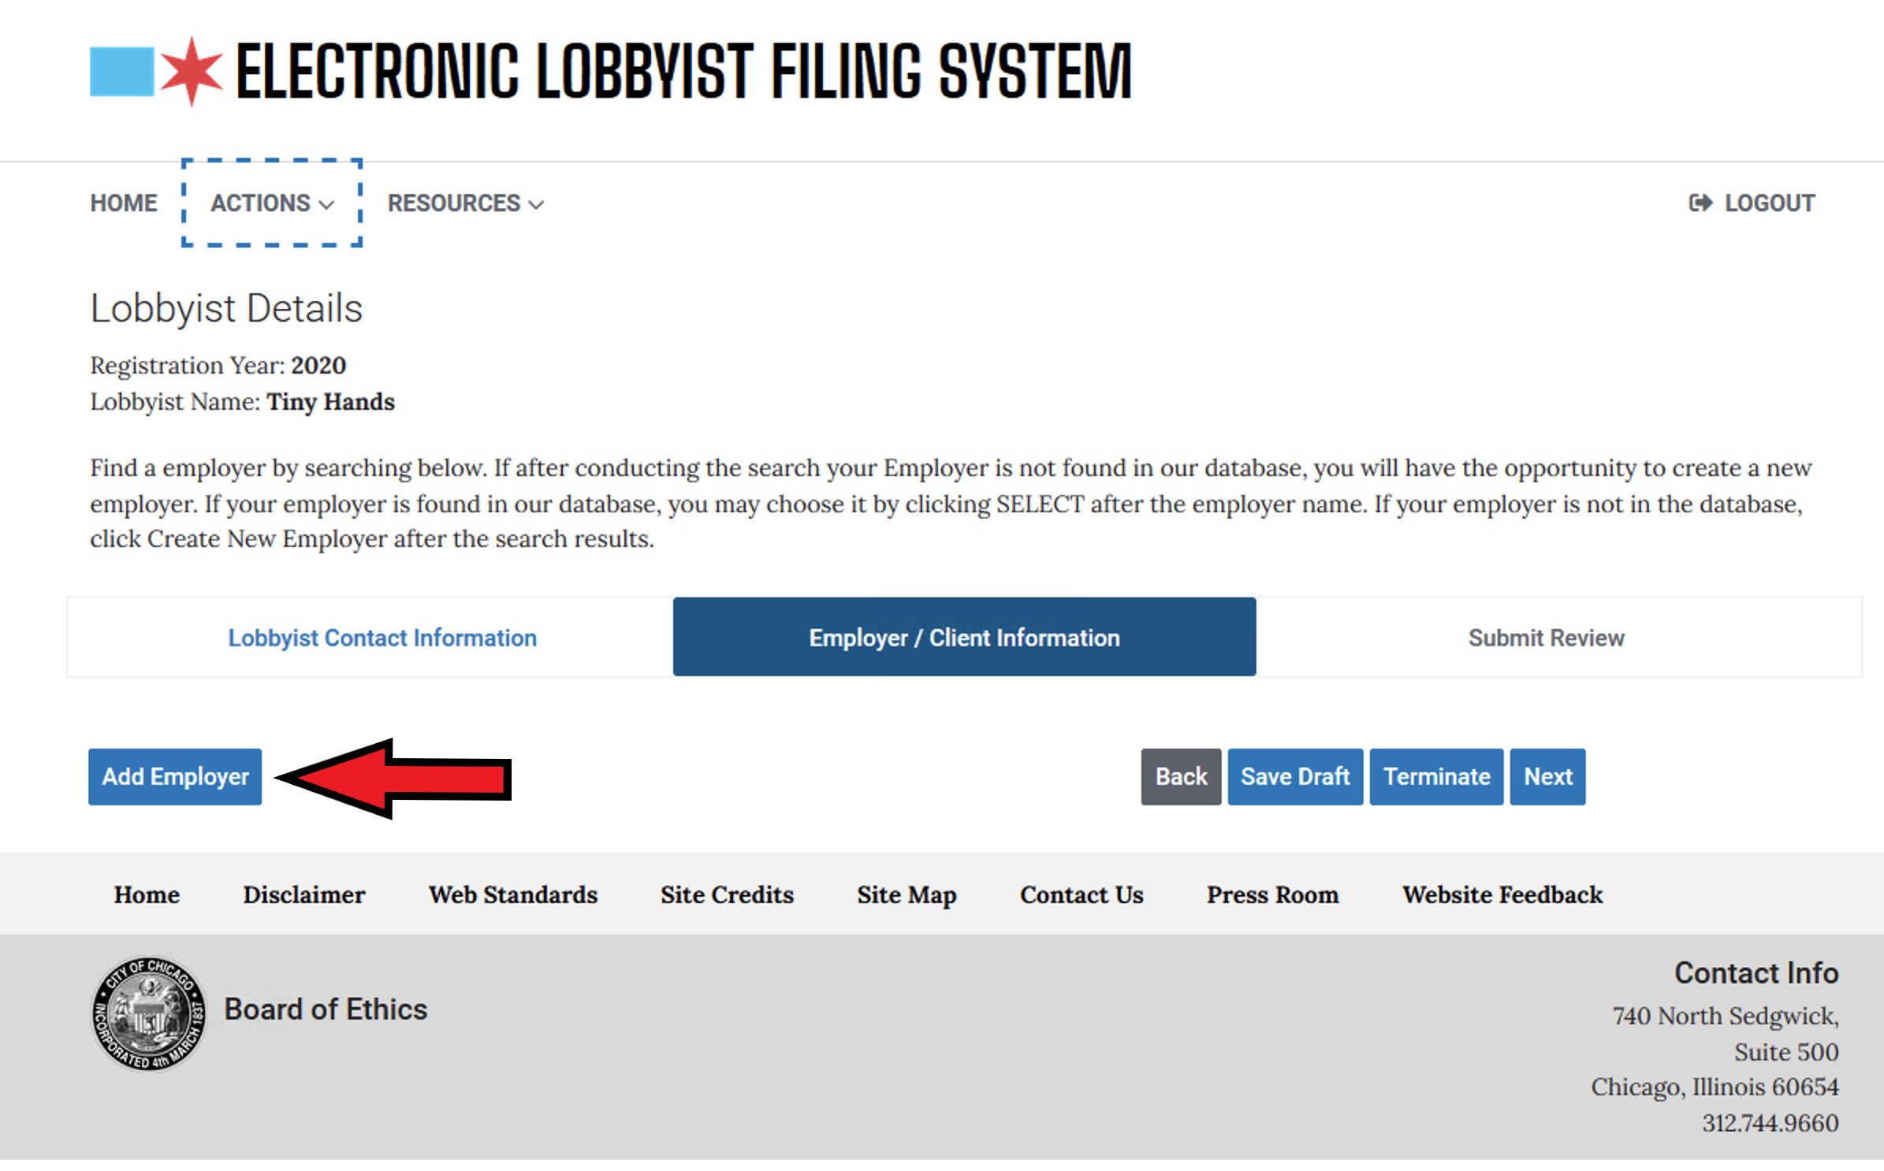
Choose Add Employer

Slide 13
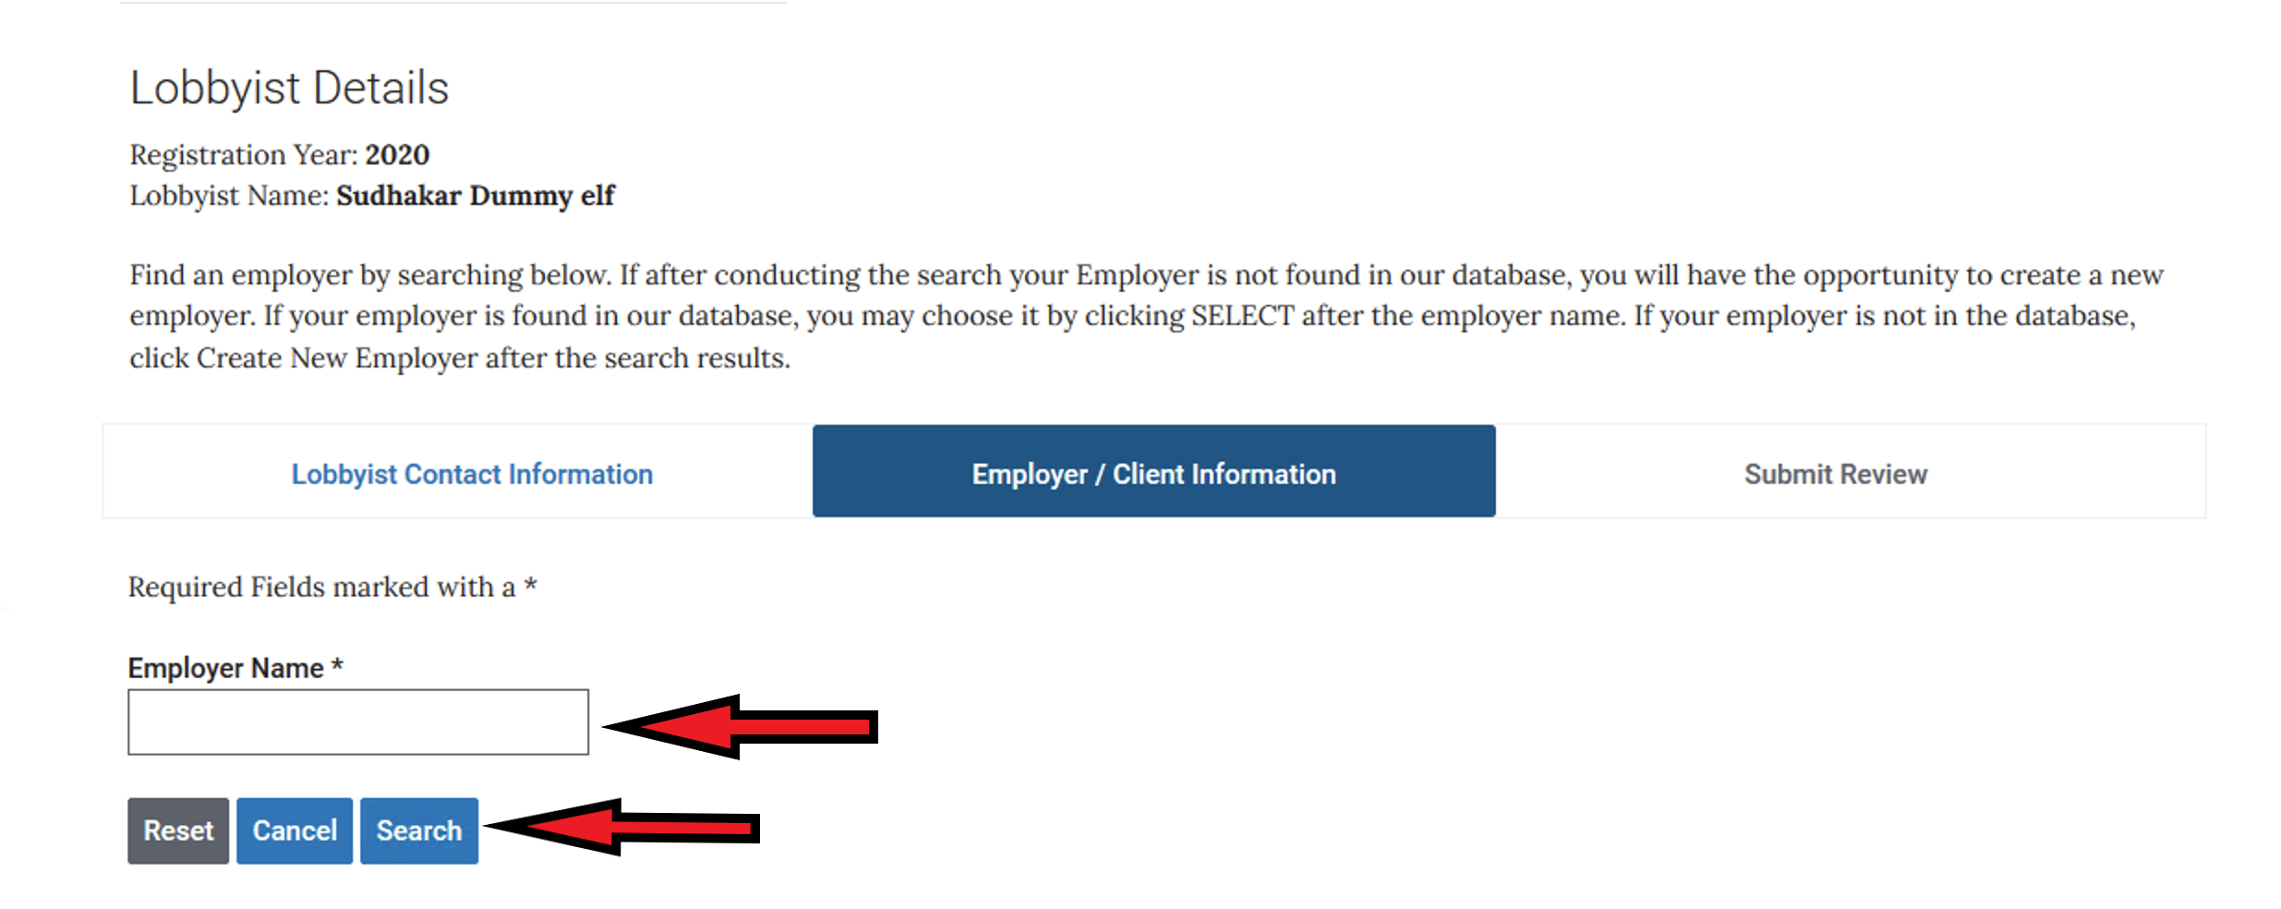
You will then conduct a search for your employer in our database. Type your employer name in the box and then hit the SEARCH button. If after conducting the search your Employer is not found in our database, you will have the opportunity to create a new employer

Slide 14
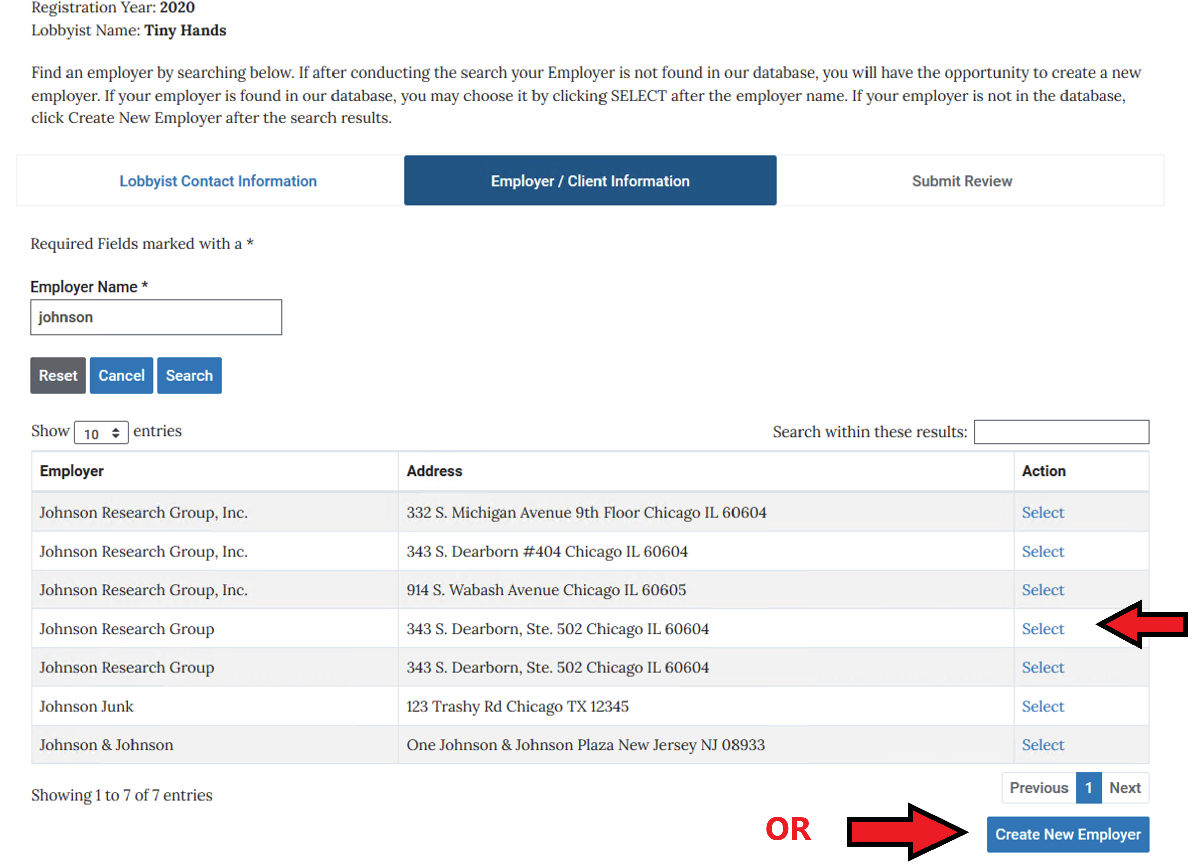
If your employer exists, you may choose it by clicking on the SELECT (if the address is different, you will have an opportunity to change it as you progress through the screens). If your employer is not in our database, click Create New Employer below.

Slide 15
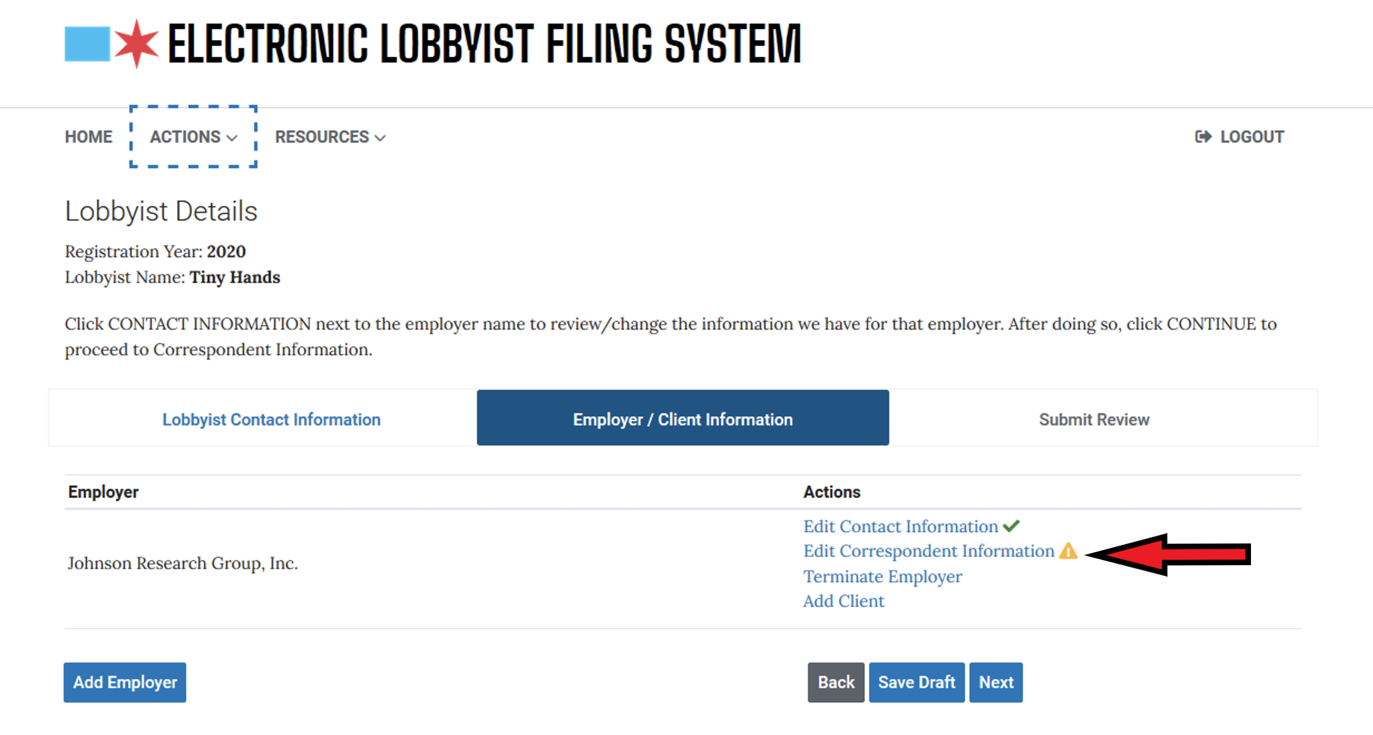
If you do not need to edit the Contact Info. For the Employer, choose Edit Correspondent Information

Slide 16
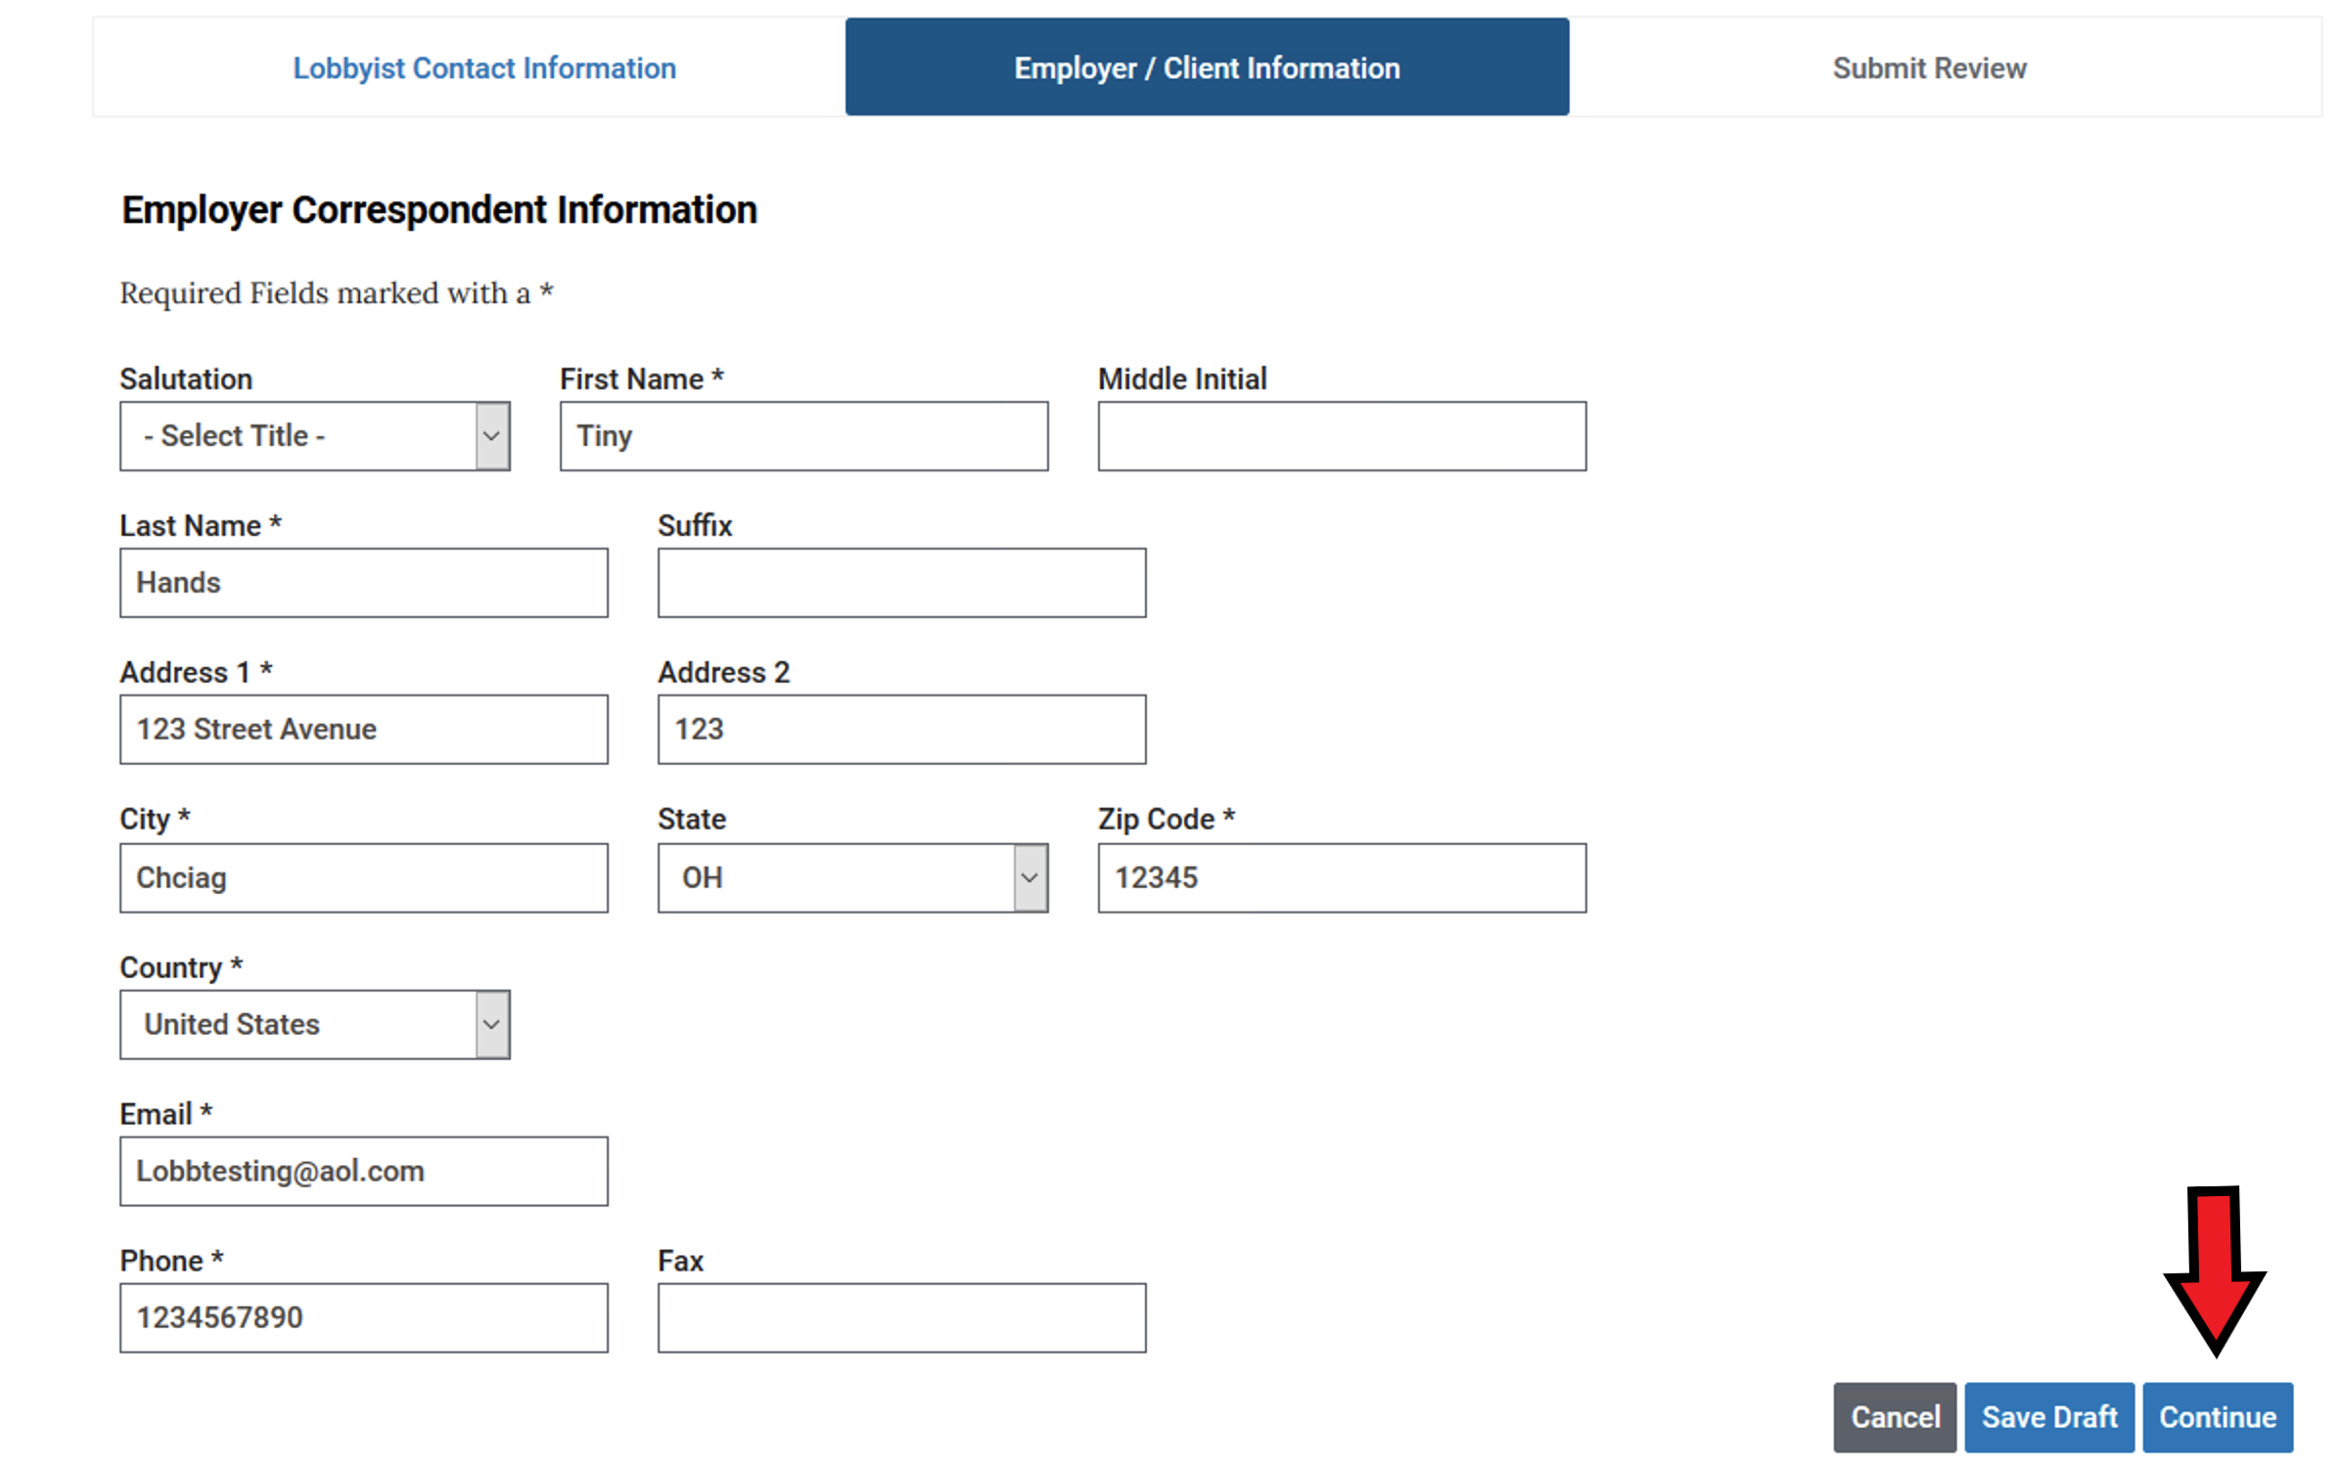
Often this will be the same as the information for the registrant. However, if there is someone else who should receive notifications regarding lobbying or who takes care of filing for you, this would be the place to add that information. Once the correspondent information is verified or changed, press the CONTINUE button at the bottom of the screen

Slide 17
Adding Clients
During the year, if you were to add clients to your registration – you would follow the same steps from the next slide forward.

Slide 18
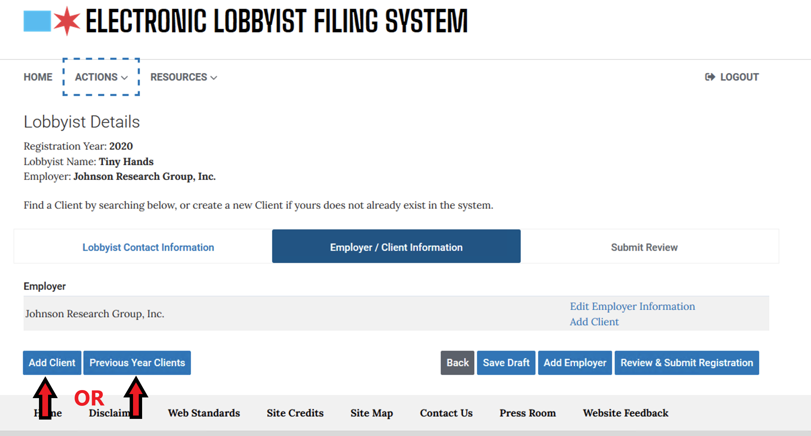
You must have at least one client in order to register as a lobbyist (even if the client and the employer are the same). Click the ADD CLIENT button to continue. This will begin a search If your client does not exist in the database, you will have the opportunity to CREATE NEW CLIENT

Slide 19
If you are returning lobbyist and want to add clients from the previous year, choose PREVIOUS YEAR CLIENTS and a drop- down list of prior clients will appear.

Slide 20
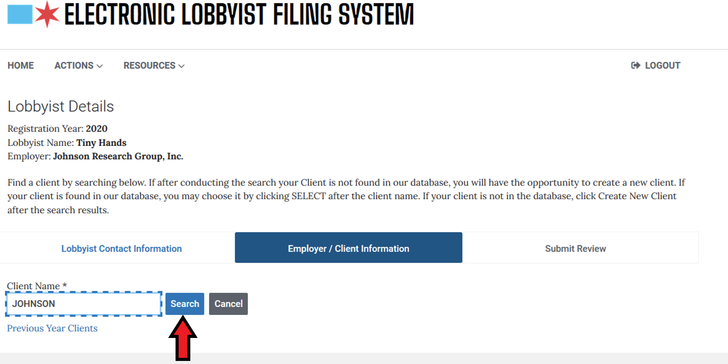
Put in the name of your client and choose Search.

Slide 21
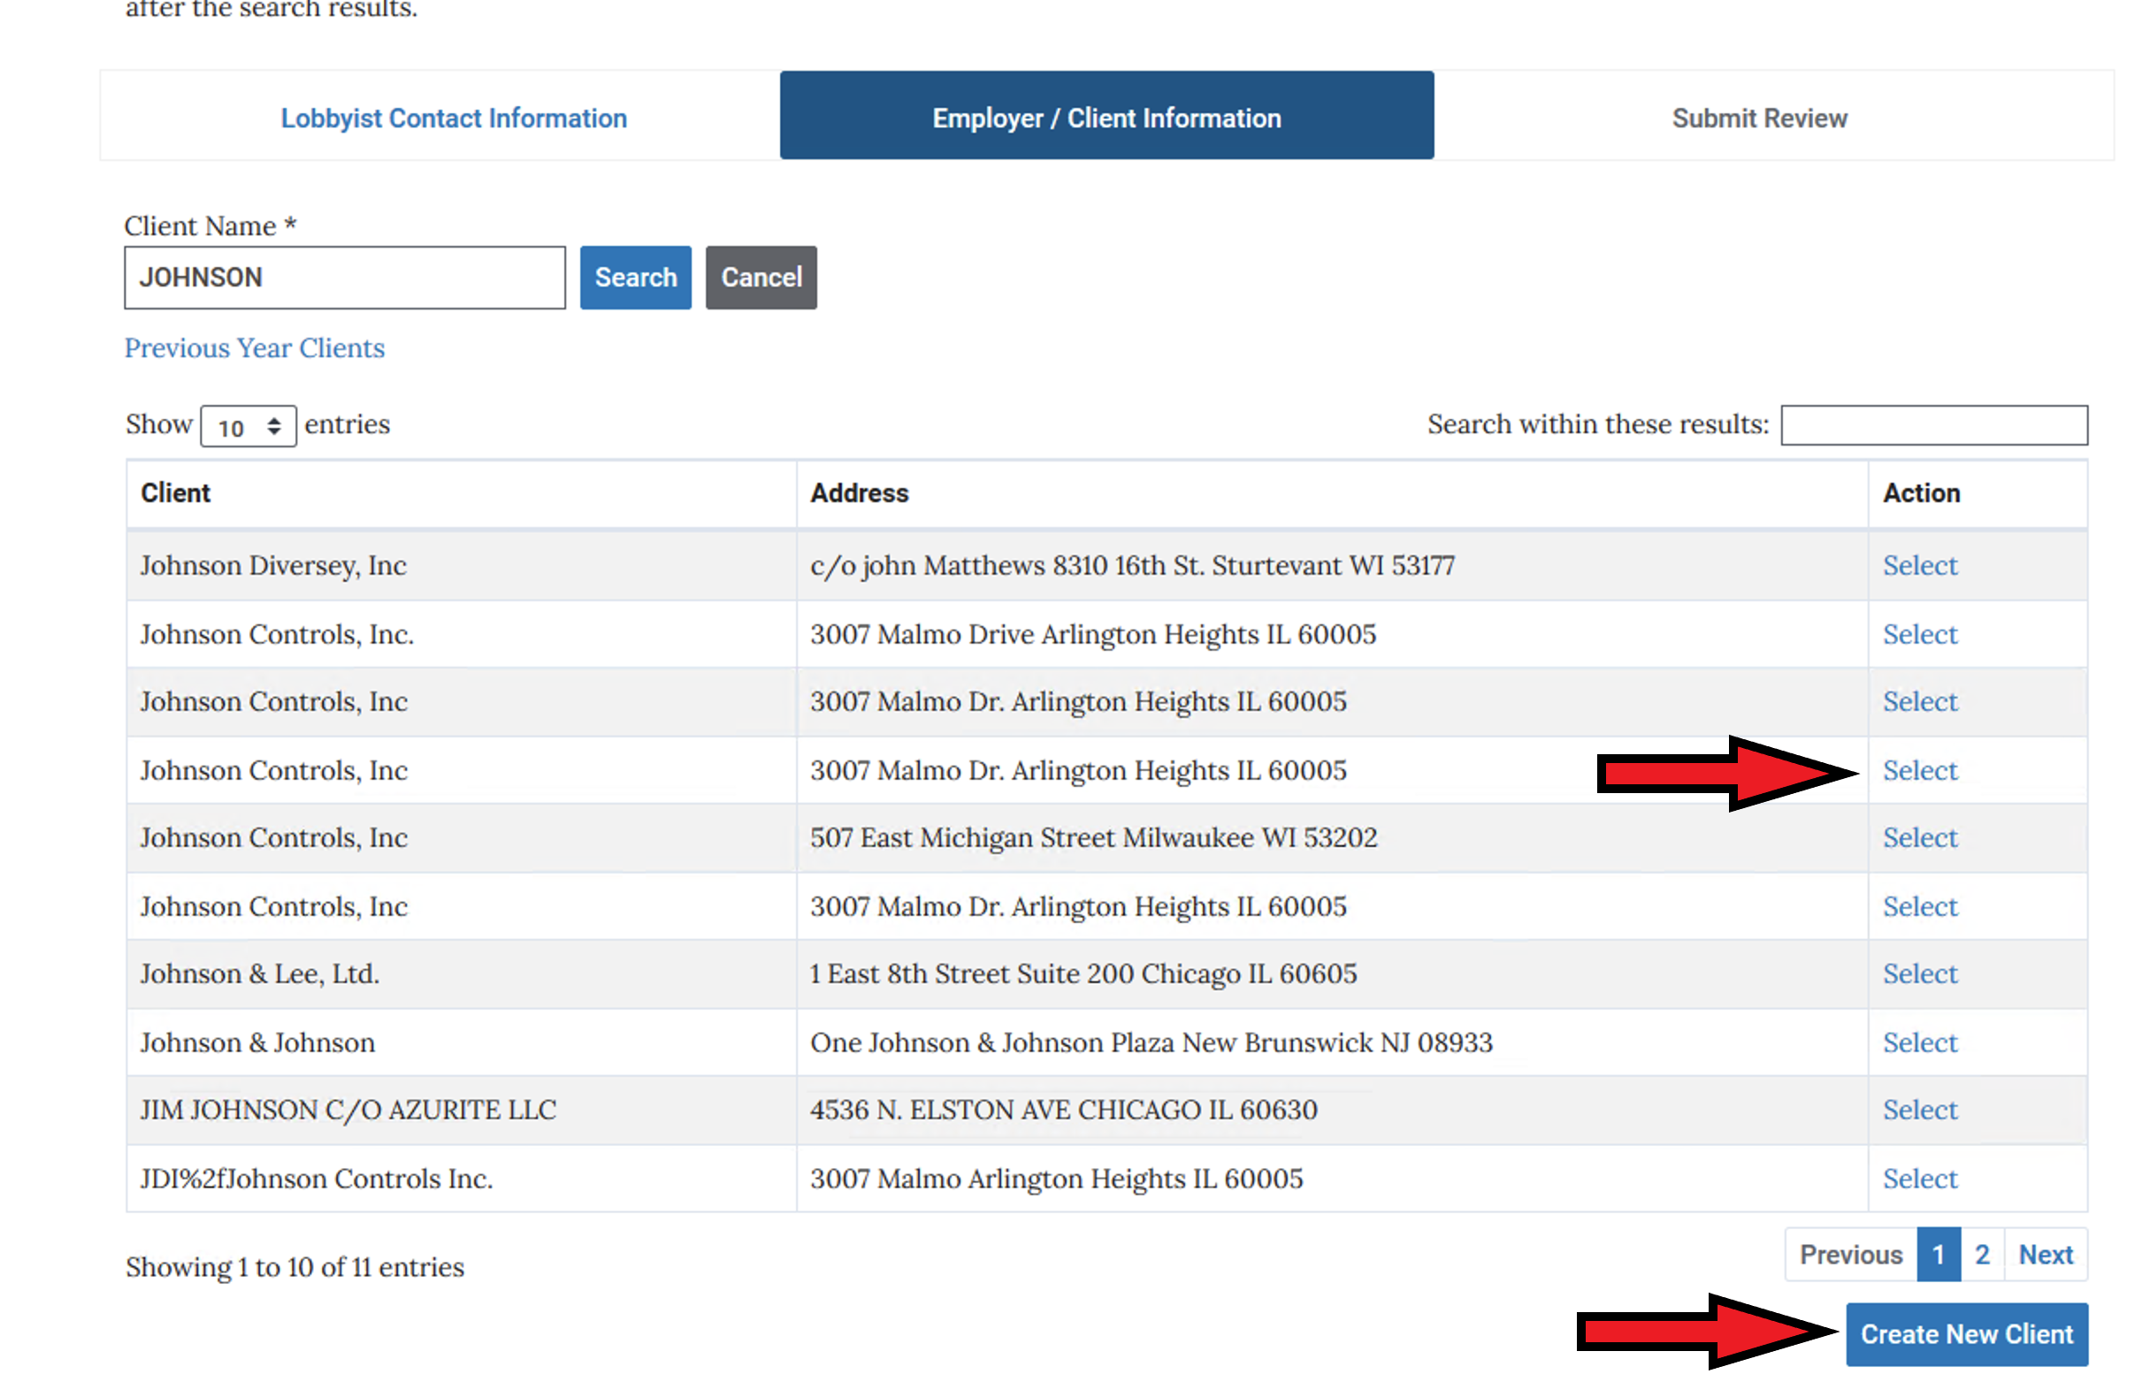
If your client was not found in our database, no options will show up for you to choose from, you will then click the CREATE NEW CLIENT button and follow the steps for adding client information.

Slide 22
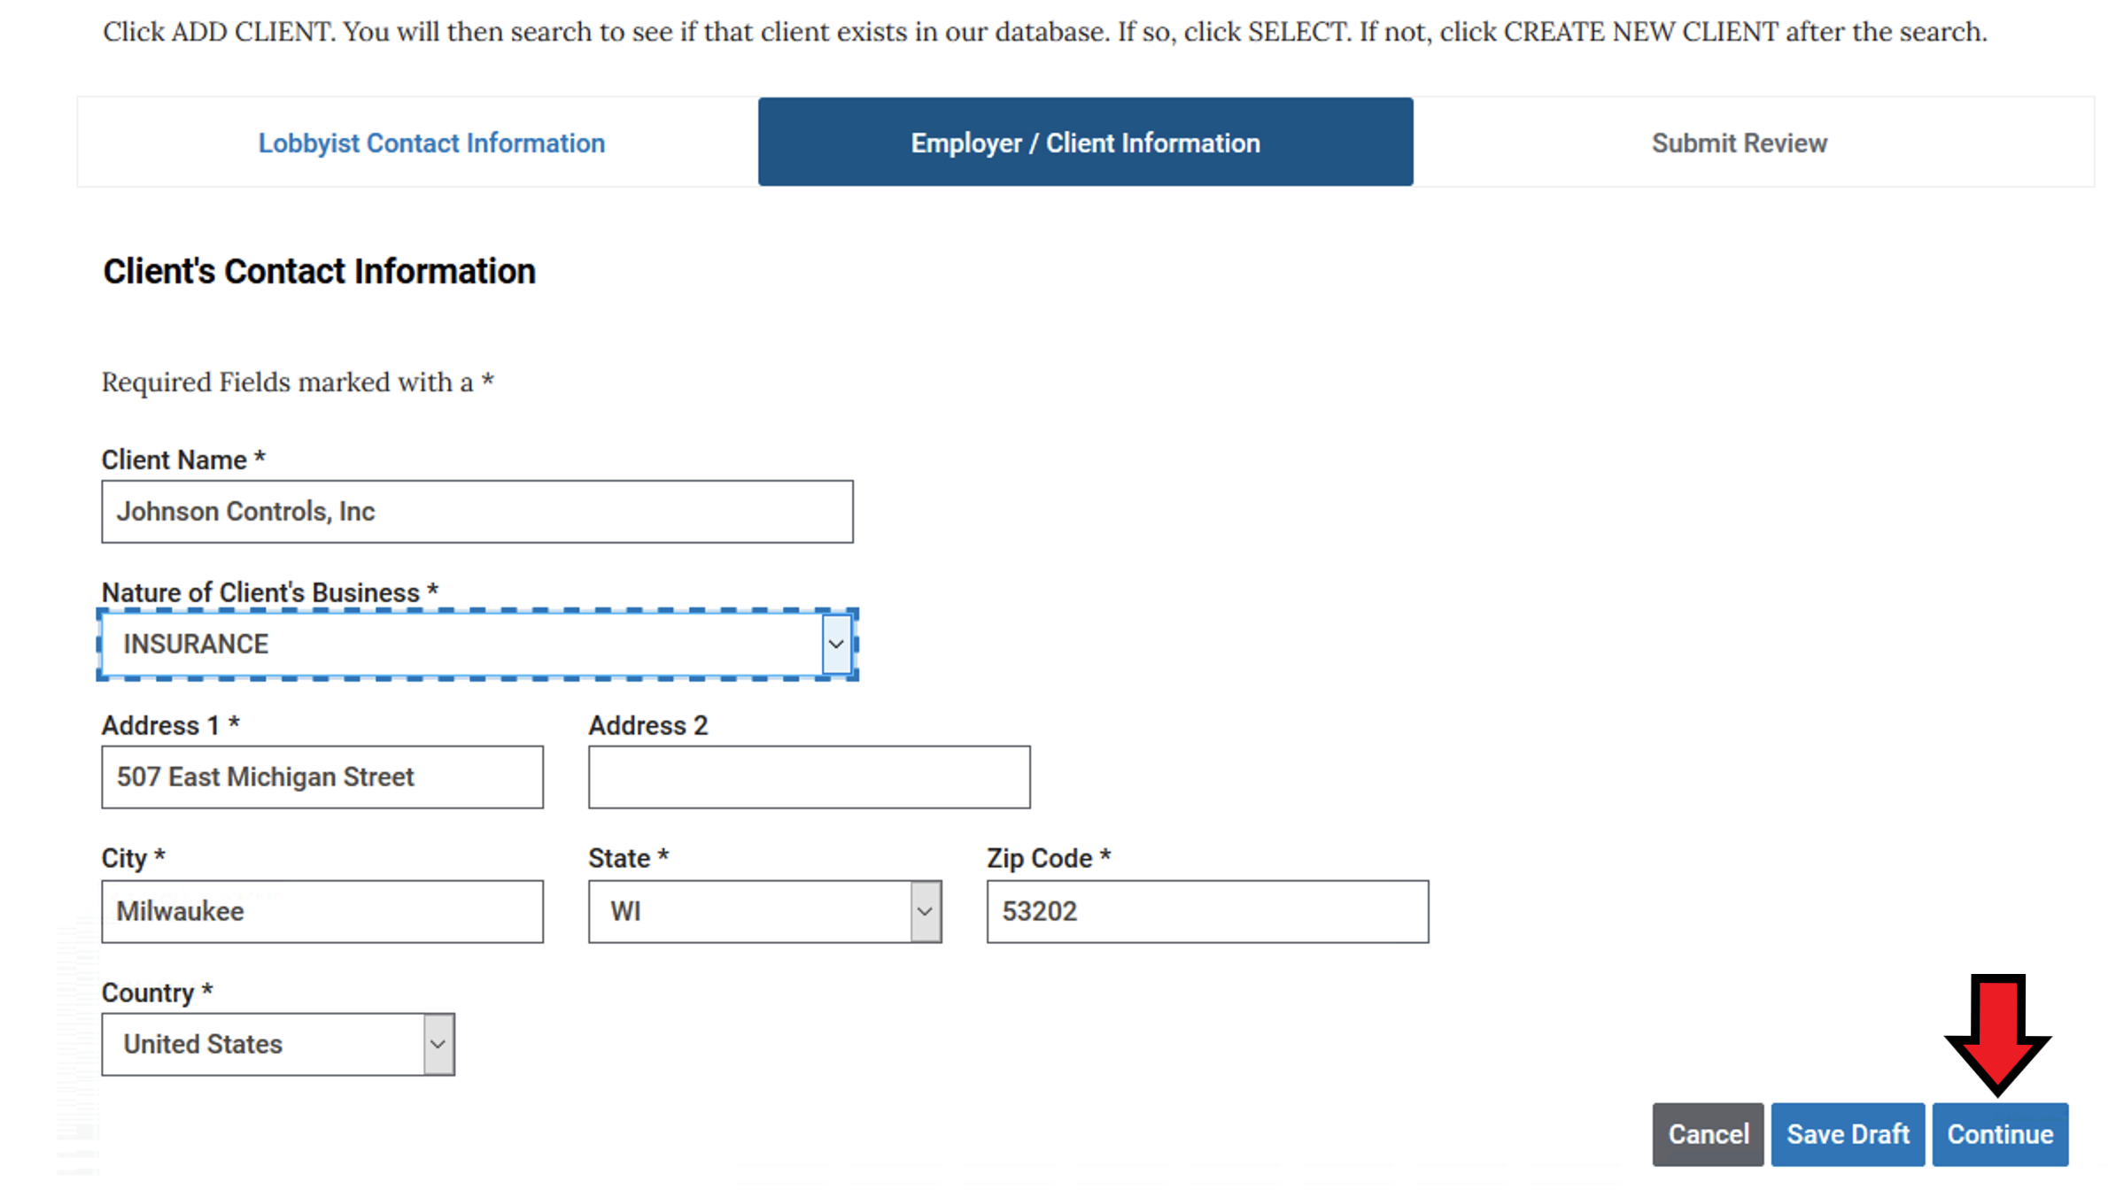
Provide all the requested information for the client and then click Continue

Slide 23
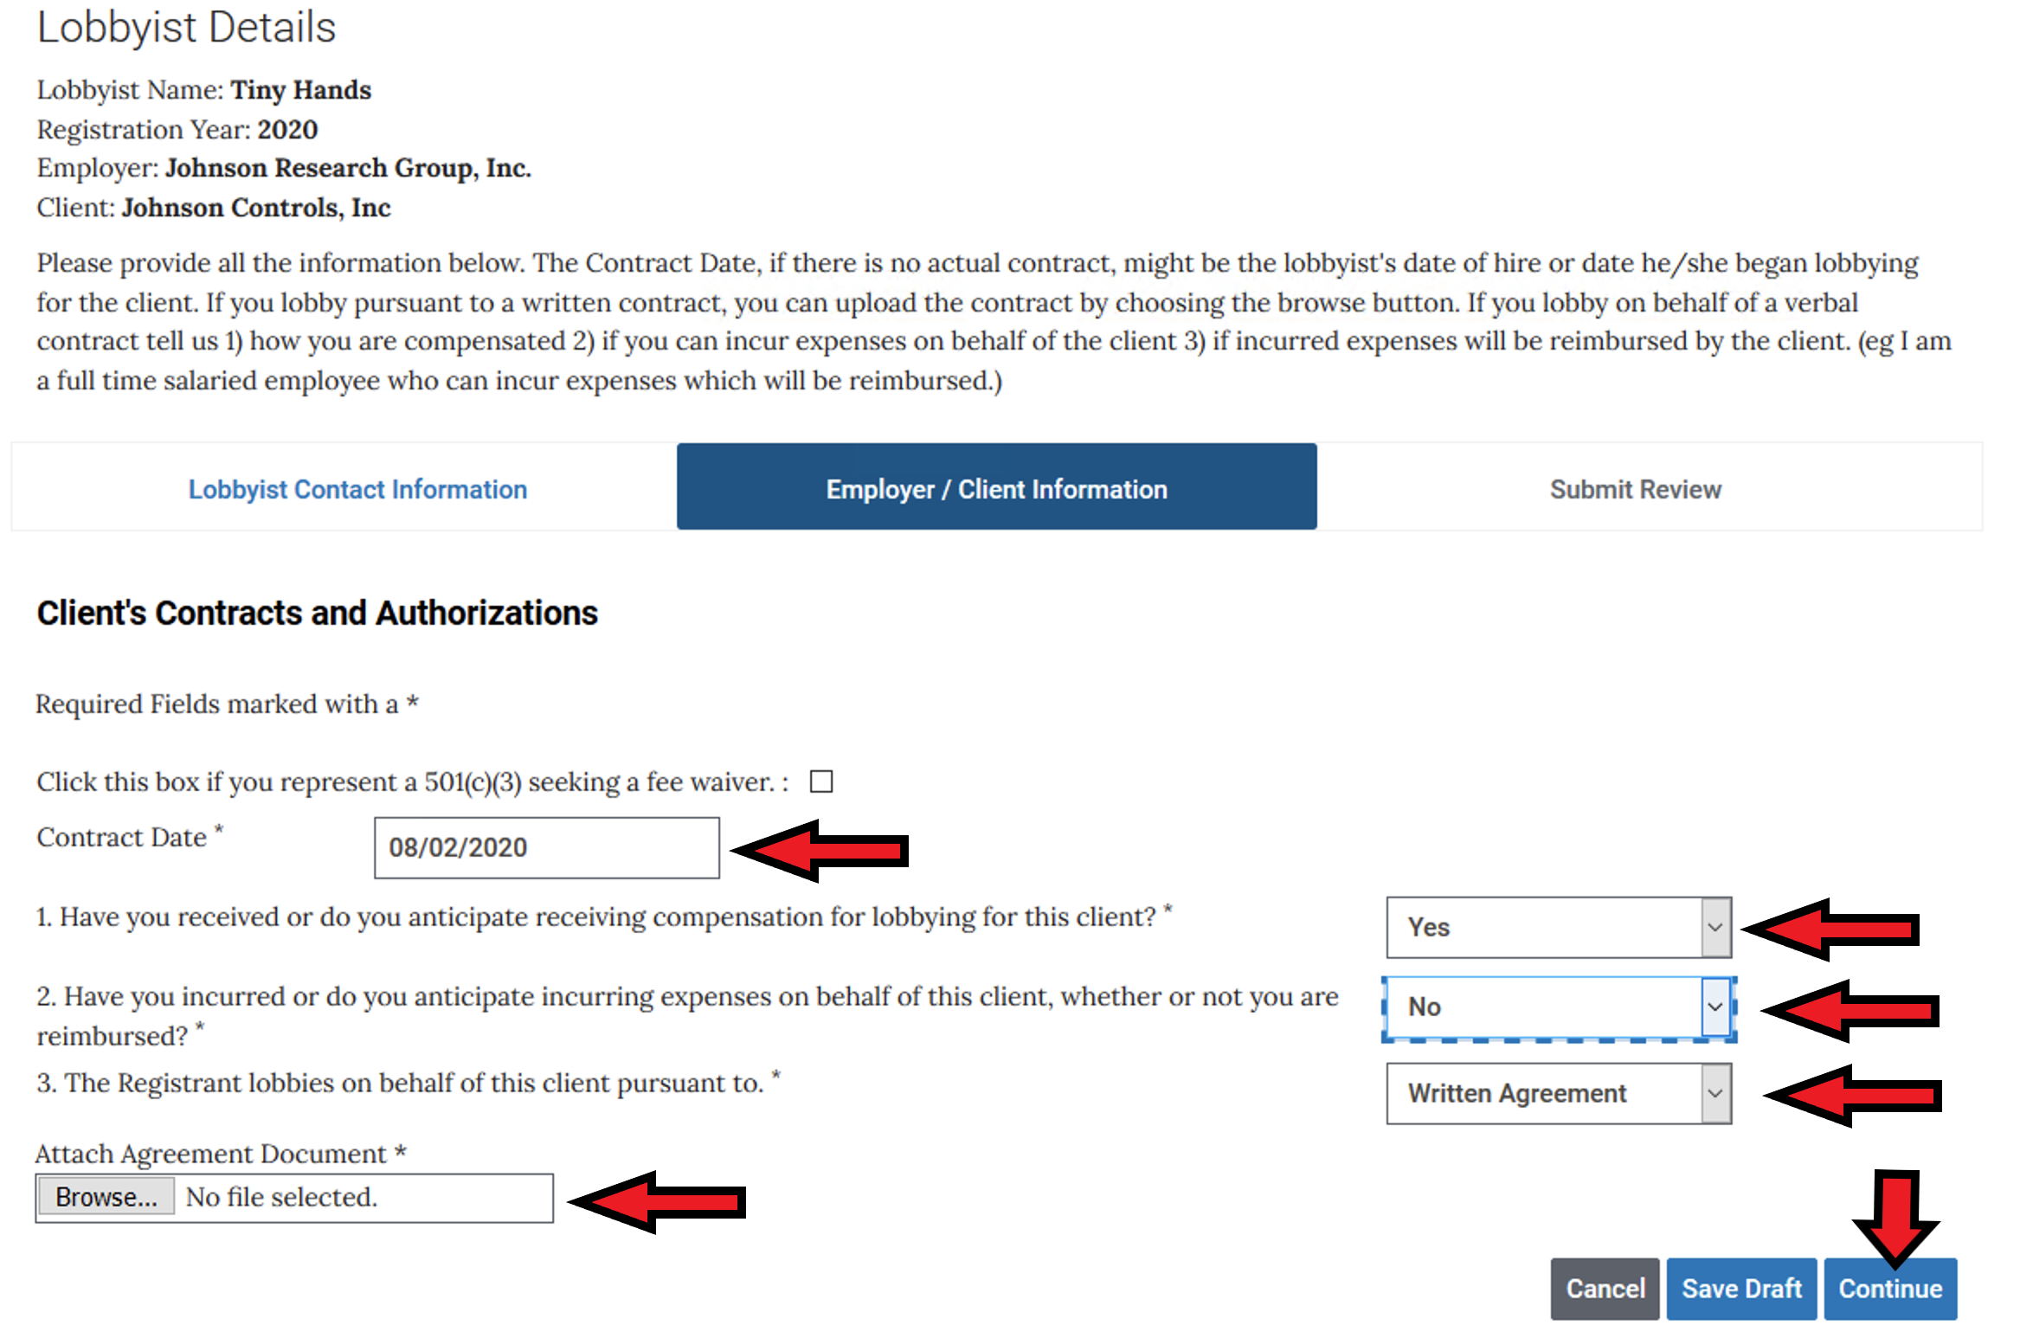
You must now provide the requested information for the client you are registering. The CONTRACT DATE, if there is no actual contract, might be the lobbyist’s date of hire or date he/she began to lobby for this client. If you lobby on behalf of the client pursuant to a written contract, you can upload the contract to your registration by choosing the browse button, finding the document on your computer (in any standard format) and choosing it. When you hit CONTINUE at the bottom, the document will be uploaded.

Slide 24
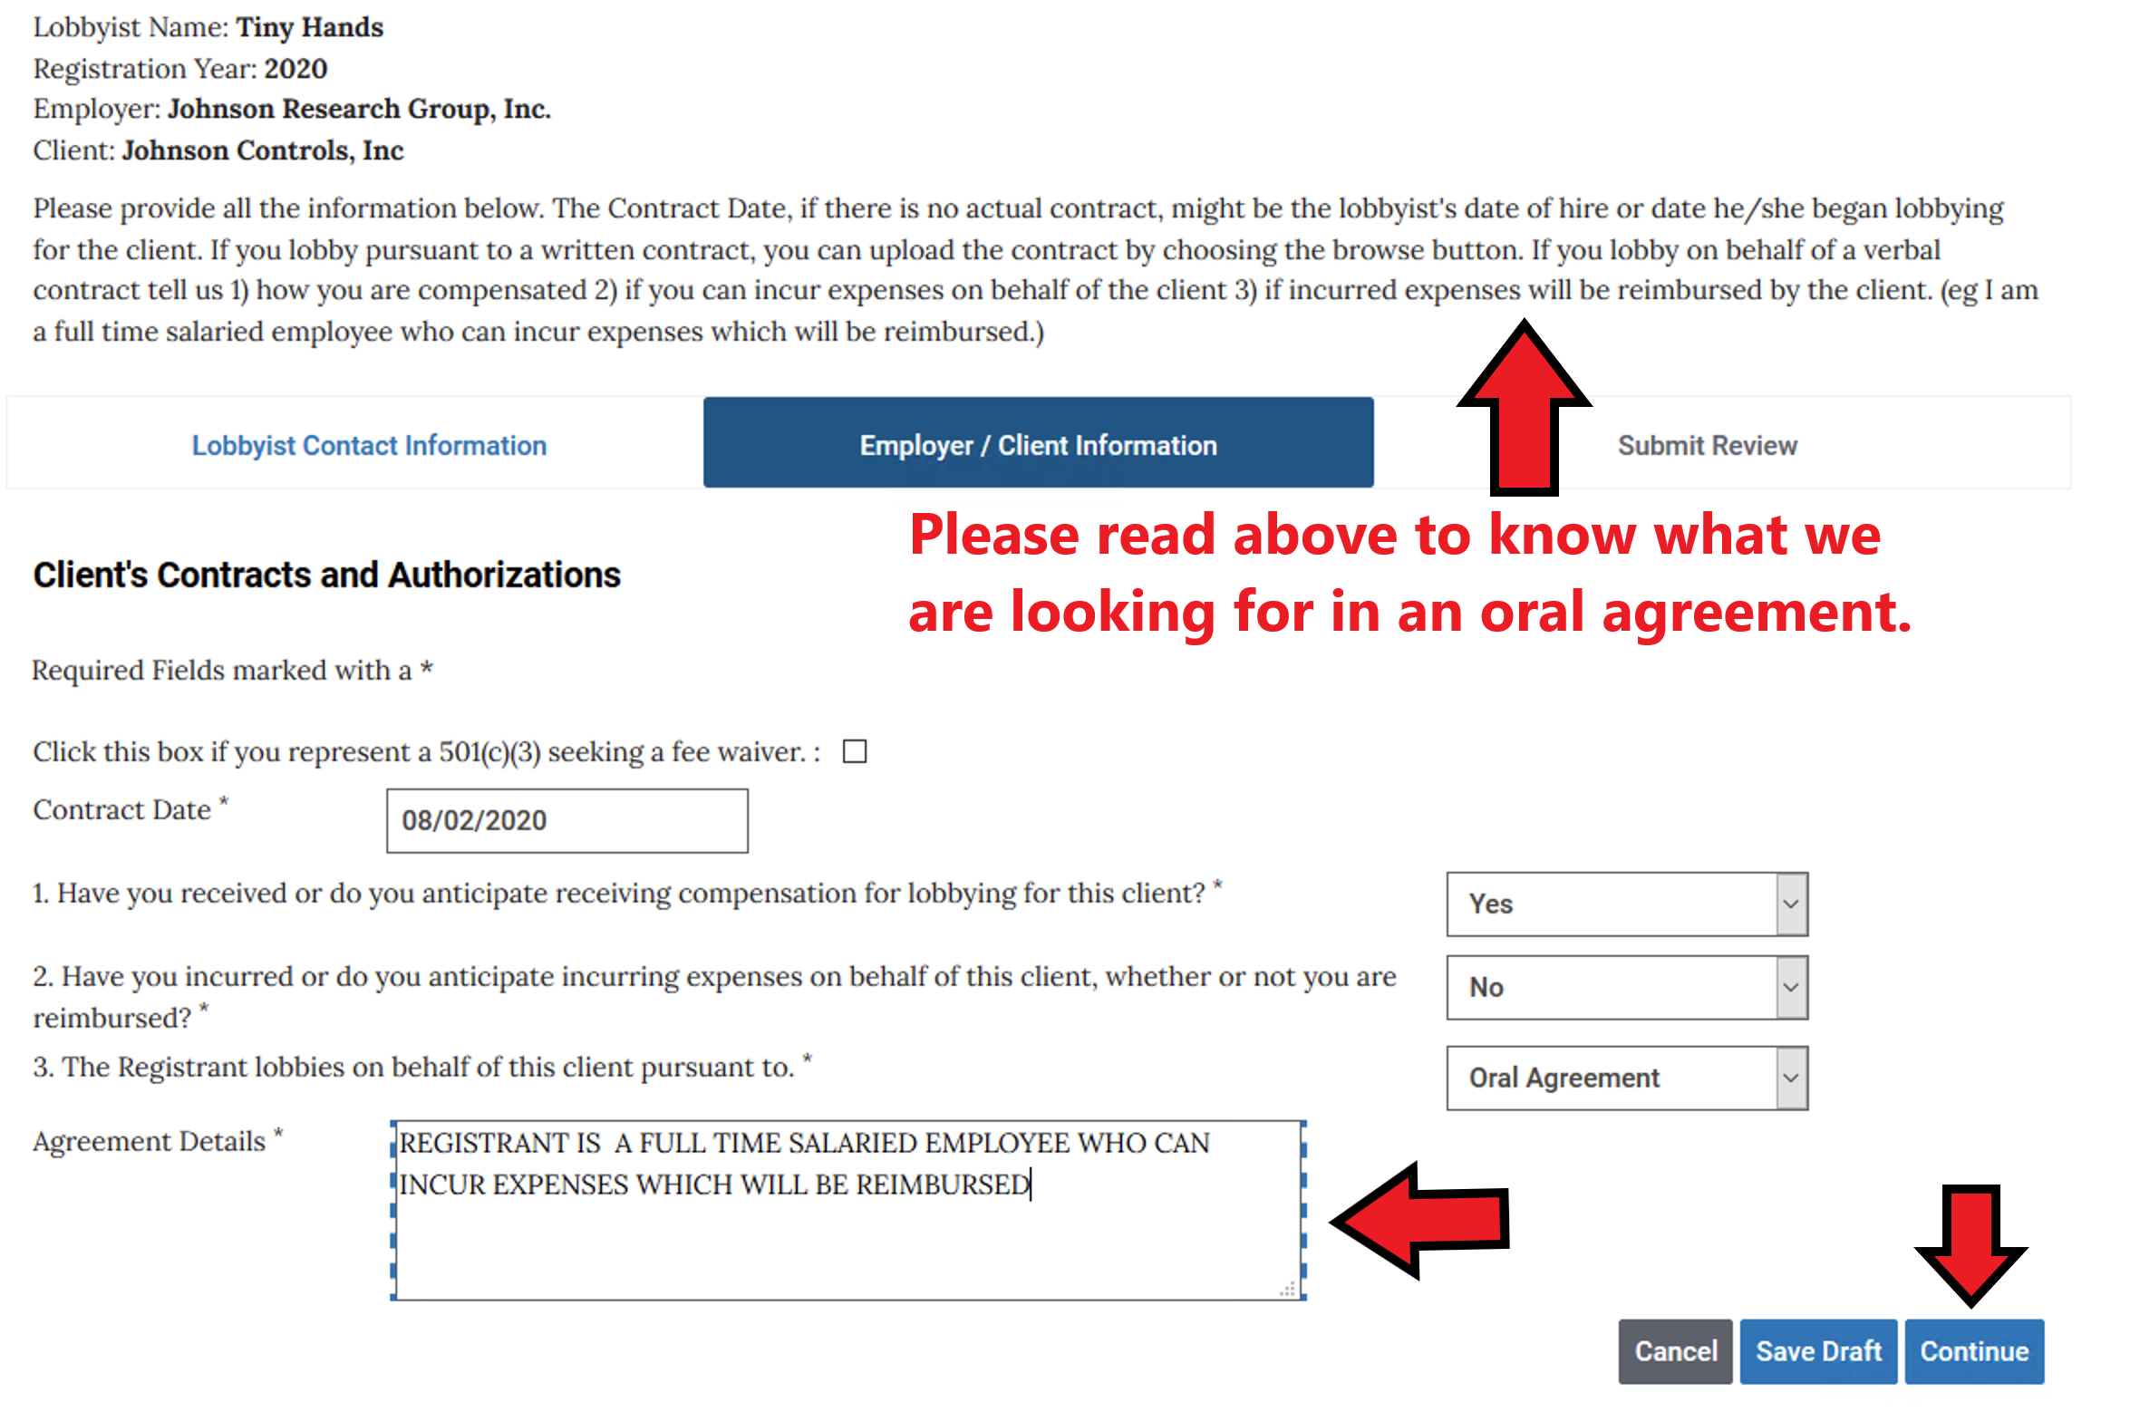
If you lobby on behalf of a verbal agreement, after choosing that option, you will be offered a box in which to supply the information we require of a verbal agreement.

Slide 25
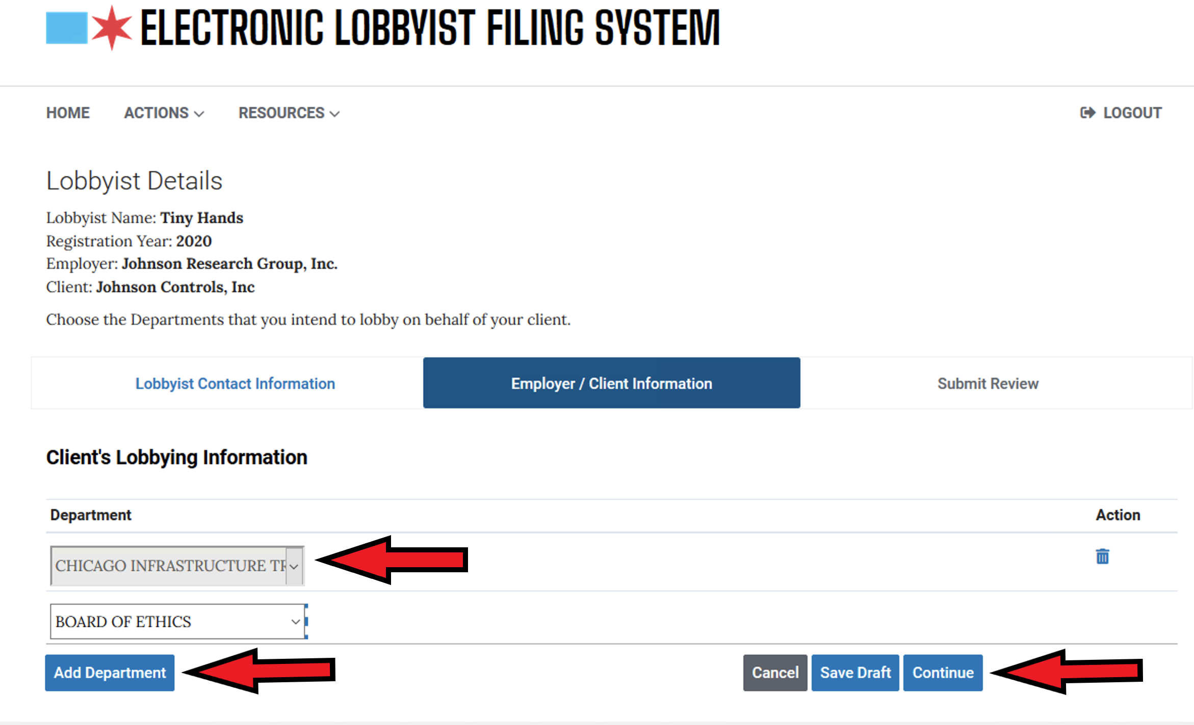
Finally, for each client, you will be asked what City Department(s) you intend to lobby on behalf of this client. Choose agencies from the drop- down list. Use the Add Department button to add more. Hit Continue when you have added all the agencies that you intend to lobby

Slide 26
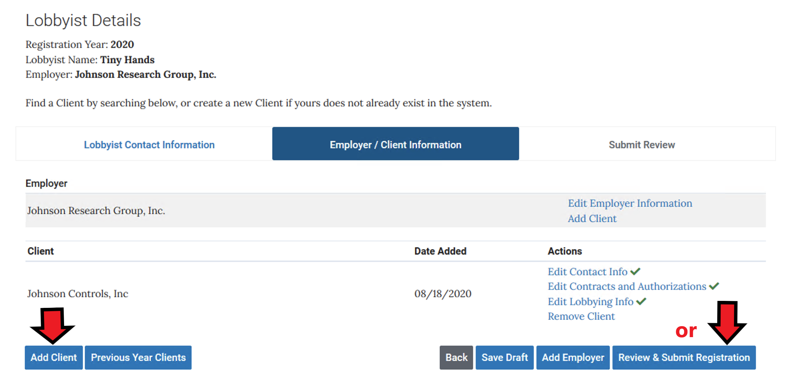
After adding all your clients, Click the REVIEW & SUBMIT REGISTRATION button to continue.

Slide 27
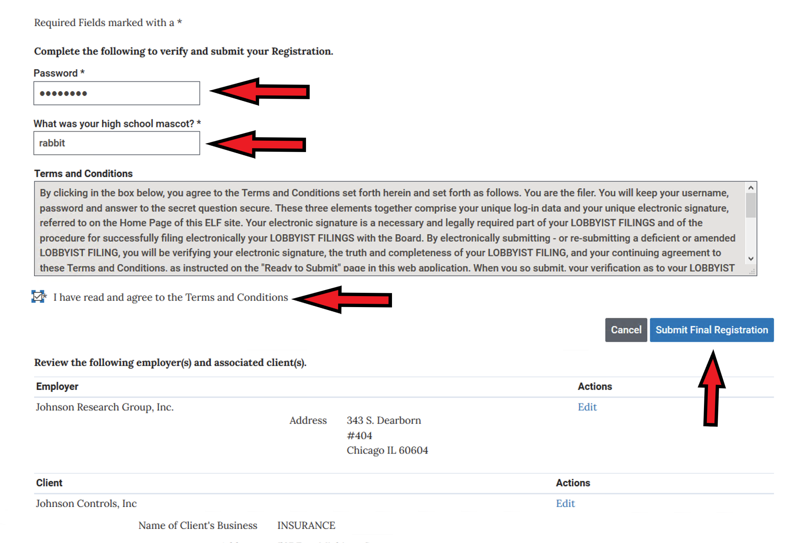
Provide your Password, Security Answer and click that you have read the terms and conditions. You can review what you are submitting by scrolling down the page. Click Submit Final Registration

Slide 28
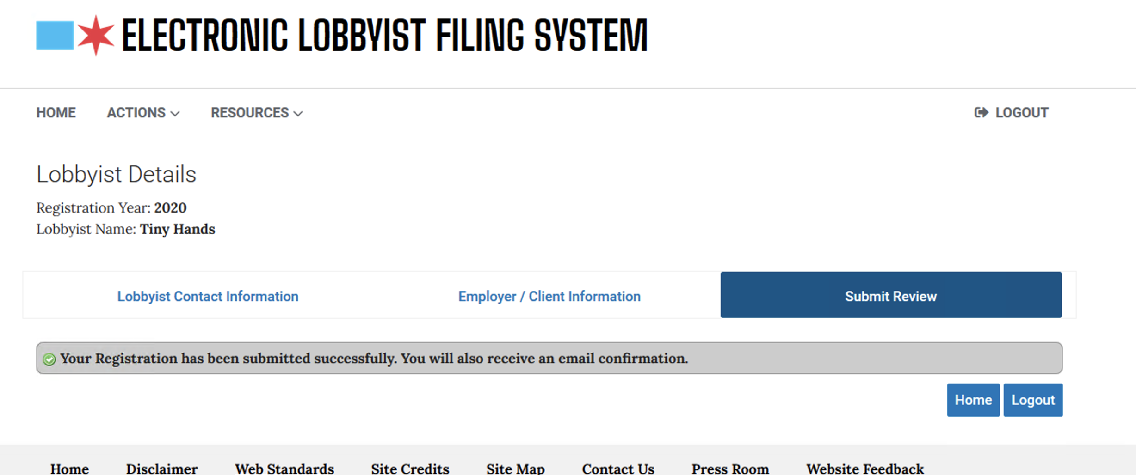
This screen tells you that you have submitted your registration successfully. You will receive an email to that effect. After Board of Ethics personnel have reviewed your registration (and all submissions must be reviewed), you will receive another email informing you of any problems that they found or, if there are no problems, that you may now pay your registration fee and finalize the registration process

Slide 29
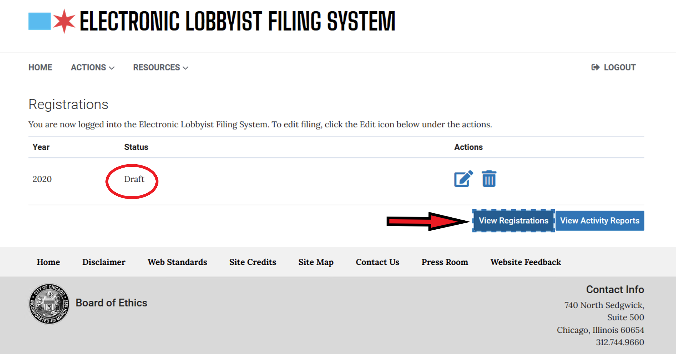
If you had a problem and your registration was rejected when you login you will see your form is in DRAFT status. It is usually a client problem, so begin by Viewing Employer Information

Slide 30
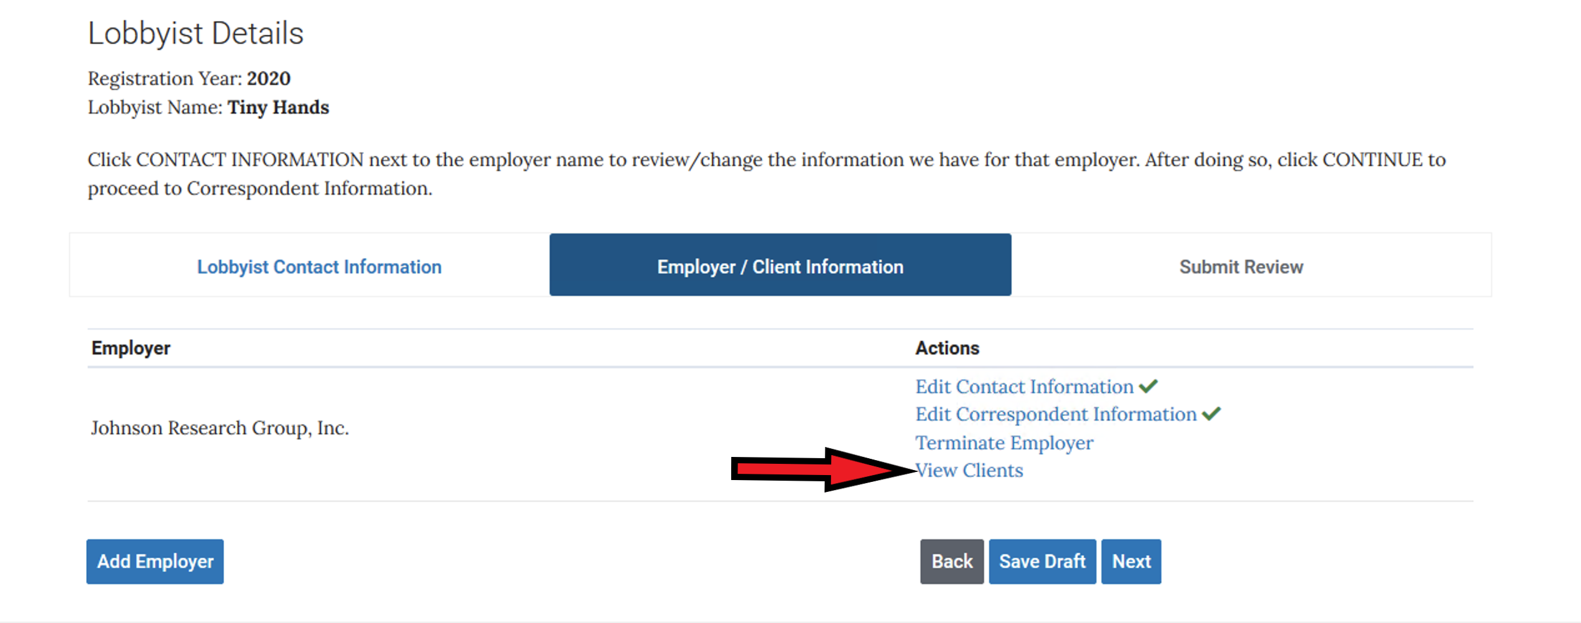
Then Click View Clients

Slide 31
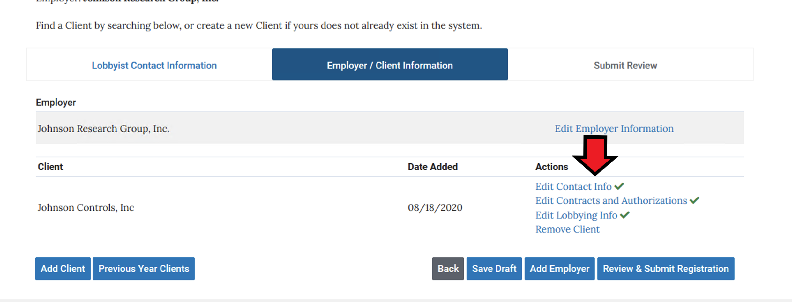
Then choose what you want to edit… usually it is a Contract issue that gets you rejected. Make the corrections and re-submit your registration.

Slide 32
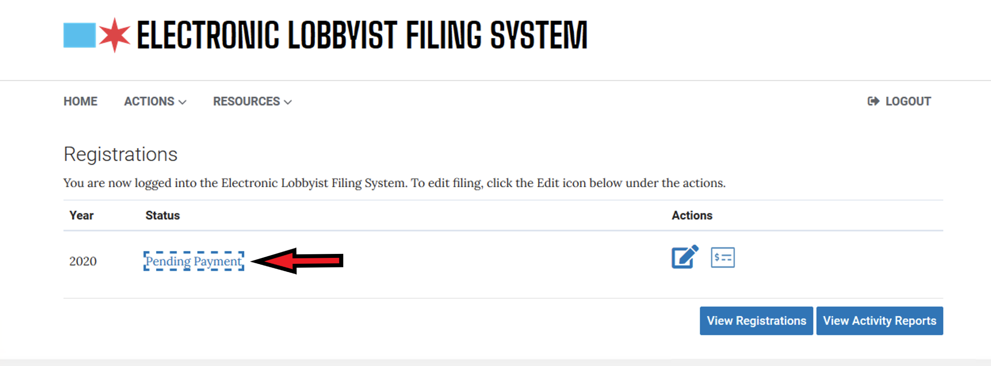
If there were no problems, you will receive an email telling you to pay your fee. Log In and click on Pending Payment. You are not registered until the fee is paid.

Slide 33
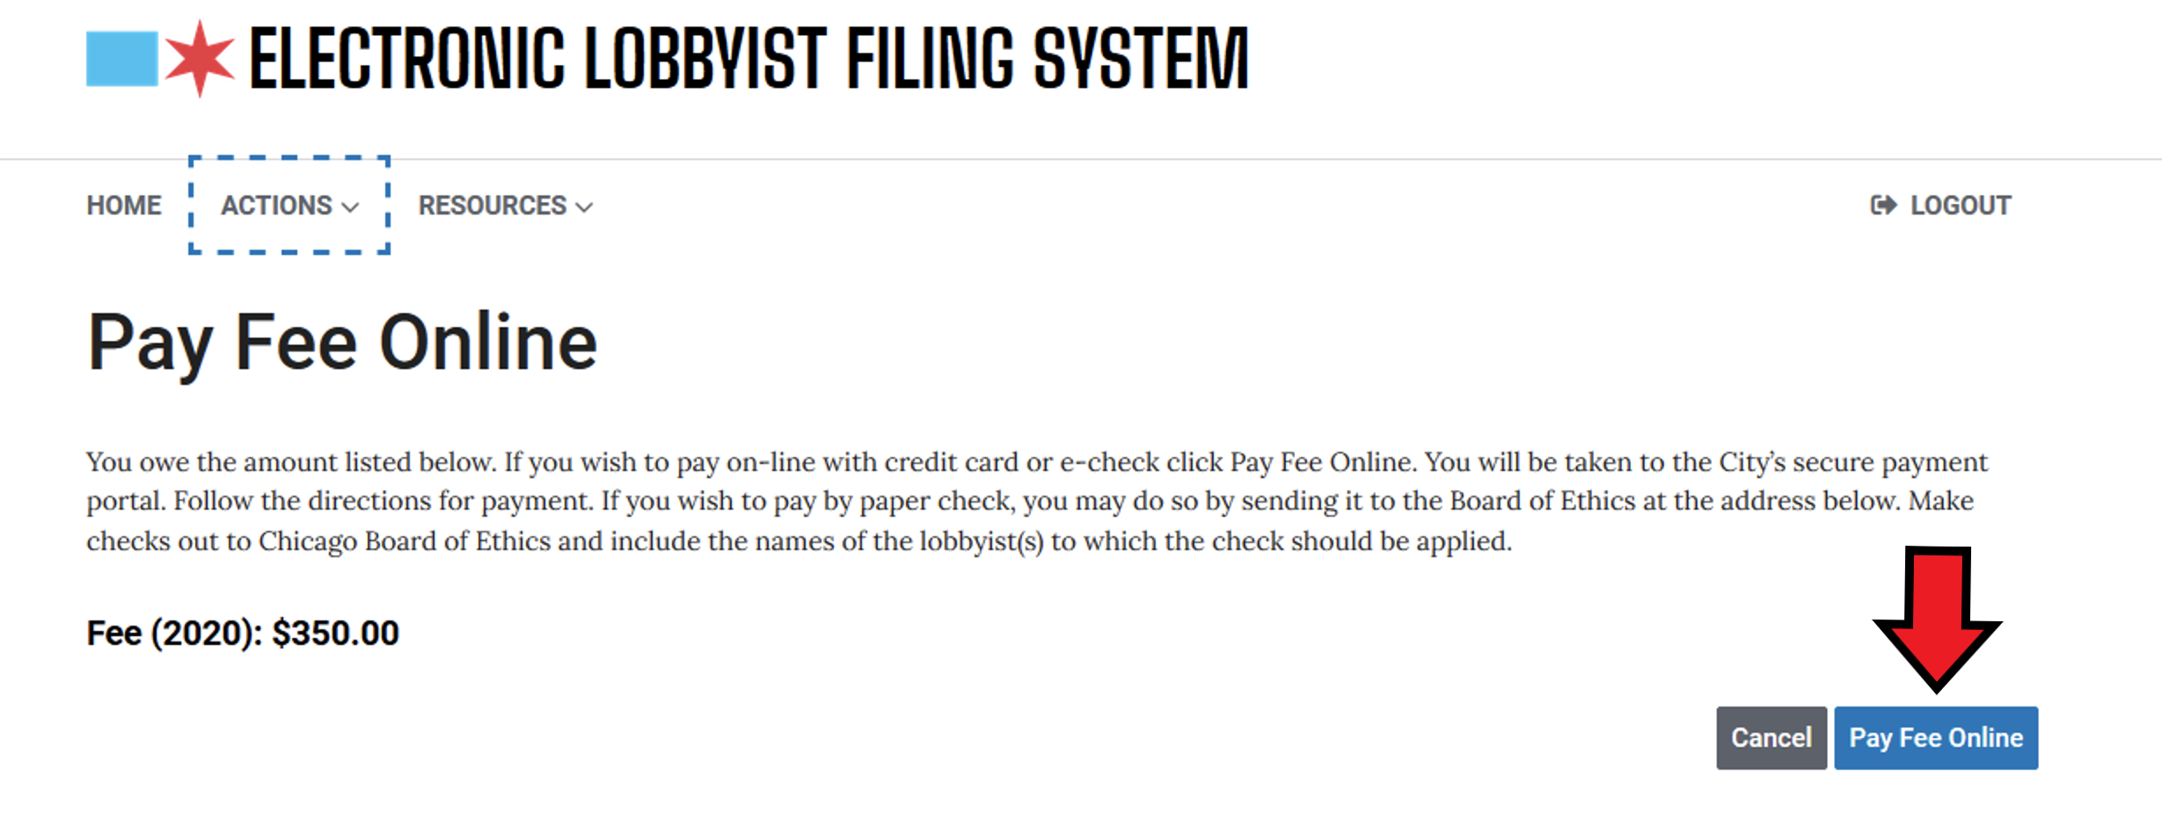
Clicking the pay fee online button will take you to the City’s payment engine. You may also send a paper check made out to the Board of Ethics – be sure to tell us the name of thelobbyist to whom the fee is to be applied.

Slide 34
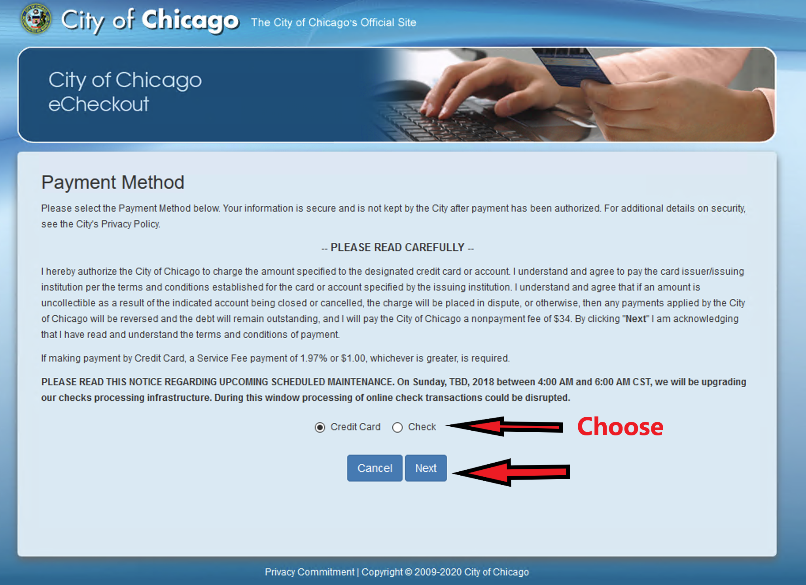
At the city payment engine, choose to pay with credit card or check and click Next. Provide the requested information.

Slide 35
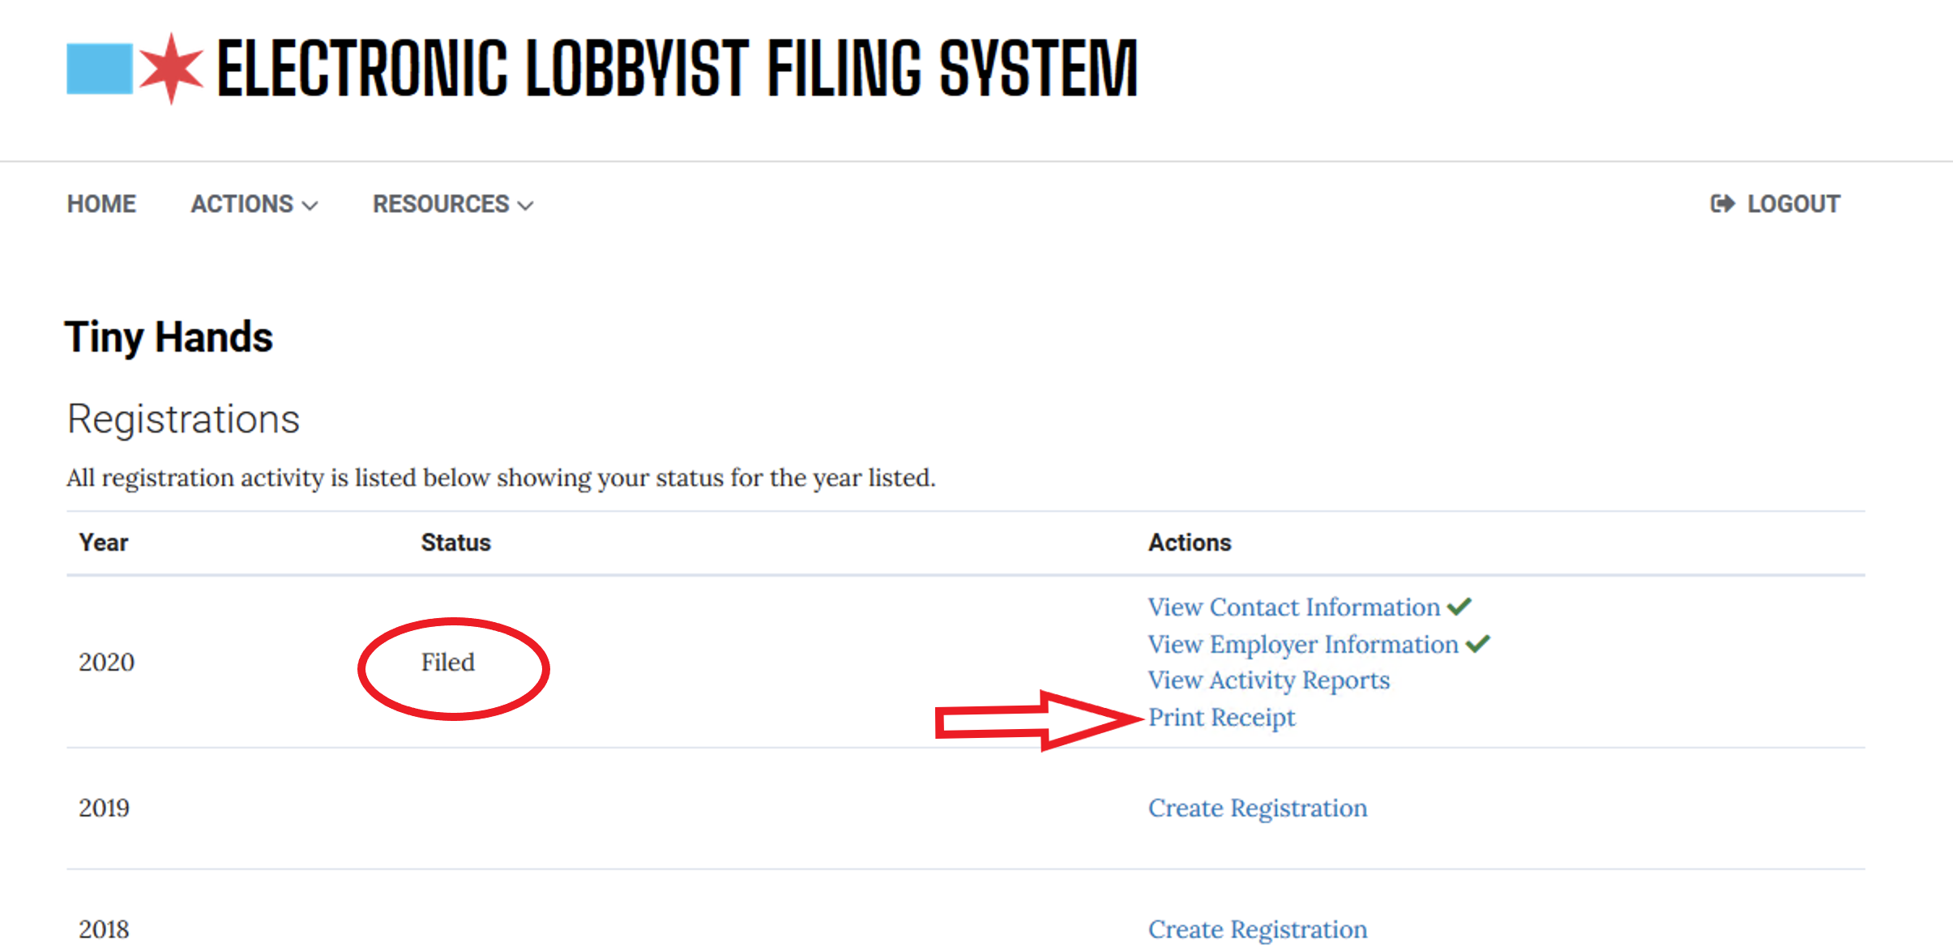
Once you have paid, your filing status will be changed to Filed. A receipt is sent to you from the payment engine. You can also print out a proof of filing by choosing Print Receipt in ELF.

Slide 36
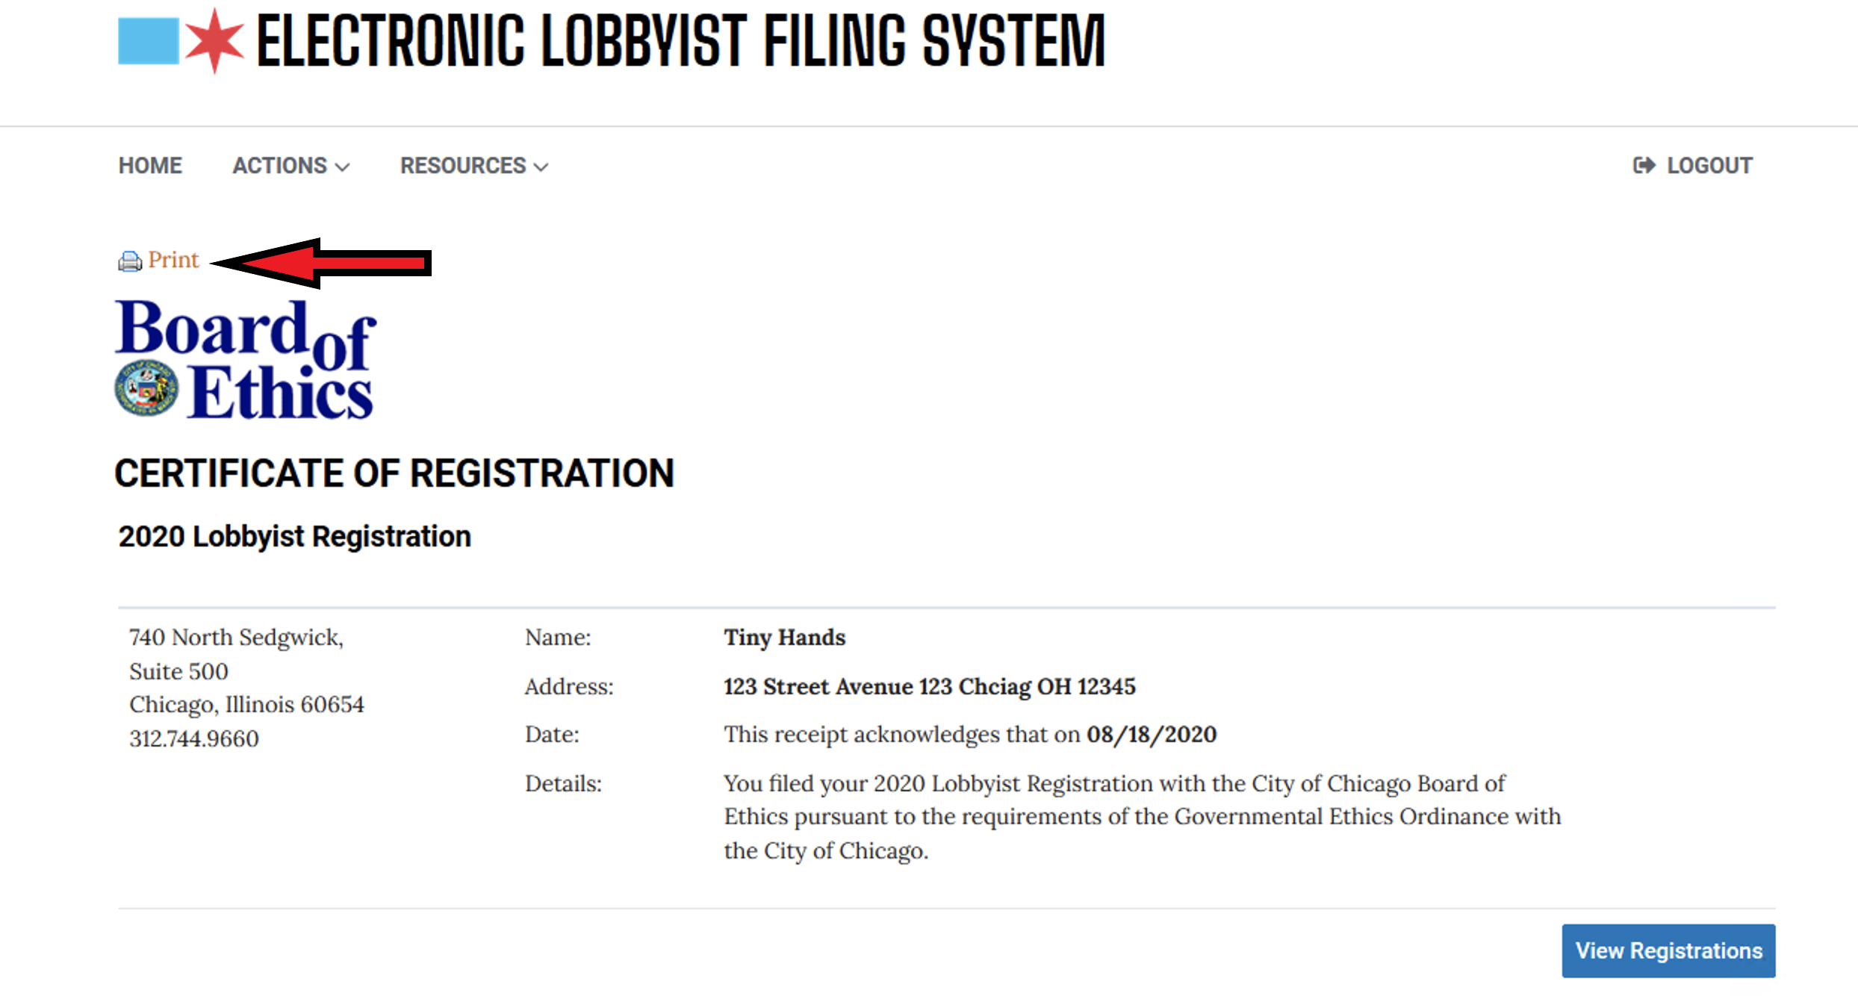
Click Print and a PDF will be produced. This receipt is not necessary for the City, but you might want one for your records.

